Slide 1
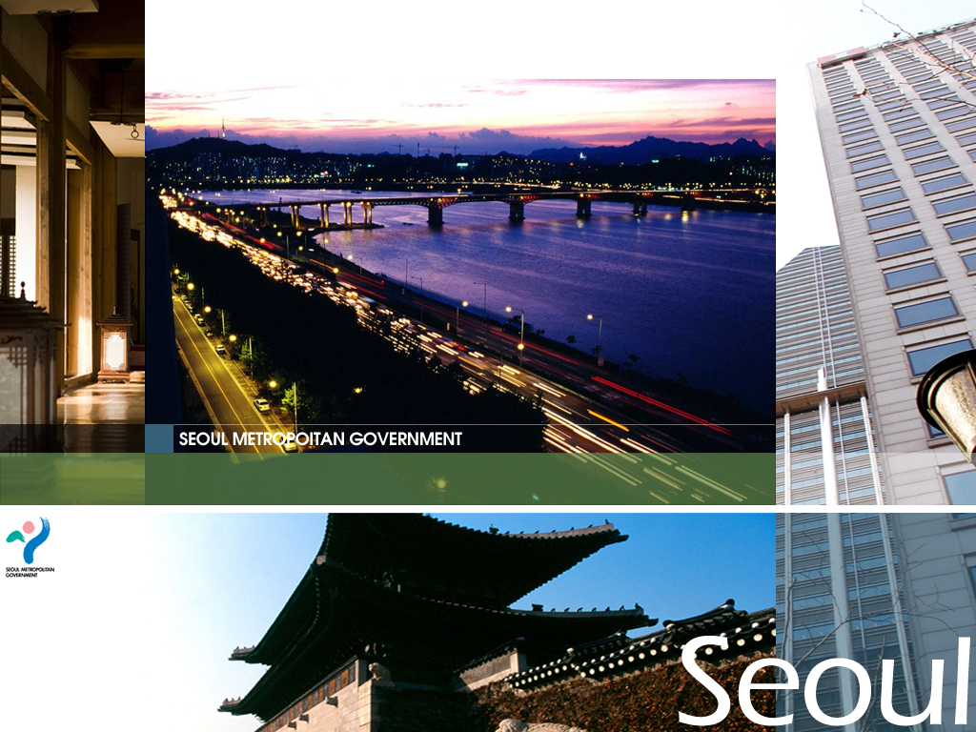
SEOUL METROPOLITAN GOVERNMENT
City Planning of
Notes:
지금부터 서울의 도시계획에 대하여 설명드리겠습니다.

Slide 2
Contents
Contents
Ⅰ_ Introduction
Ⅱ_ Master Plan
Ⅲ_ Main Projects
Notes:
주요내용은 도시현황, 도시기본계획, 주요 도시정책 등입니다

Slide 3
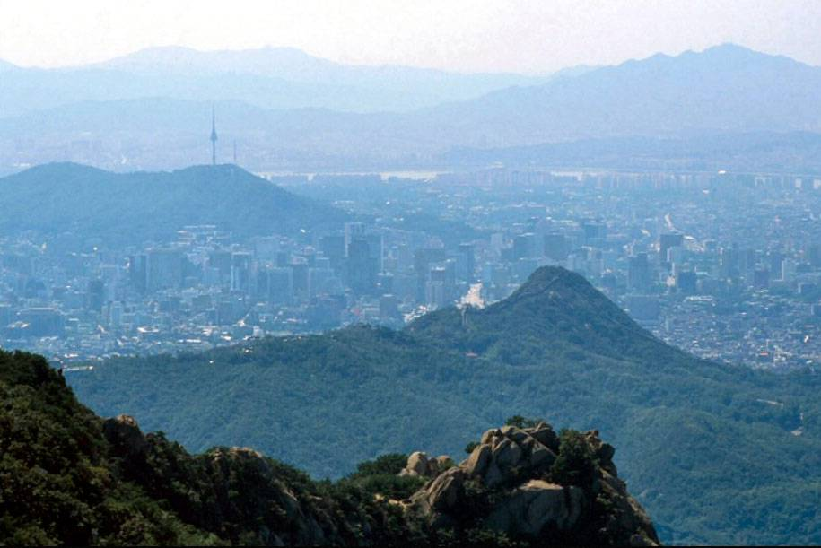
Introduction

Slide 4
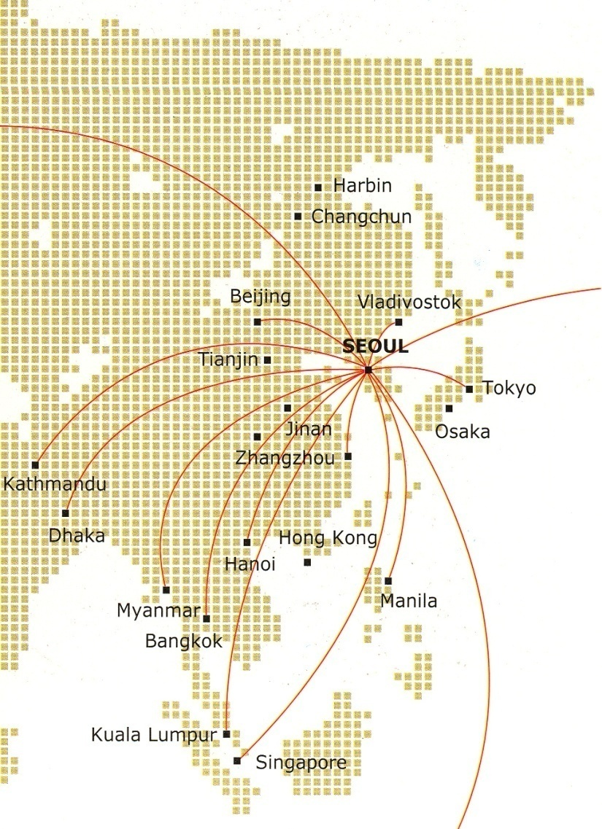
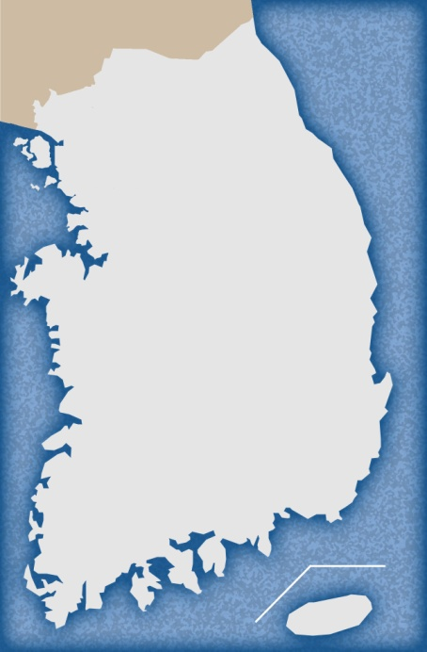
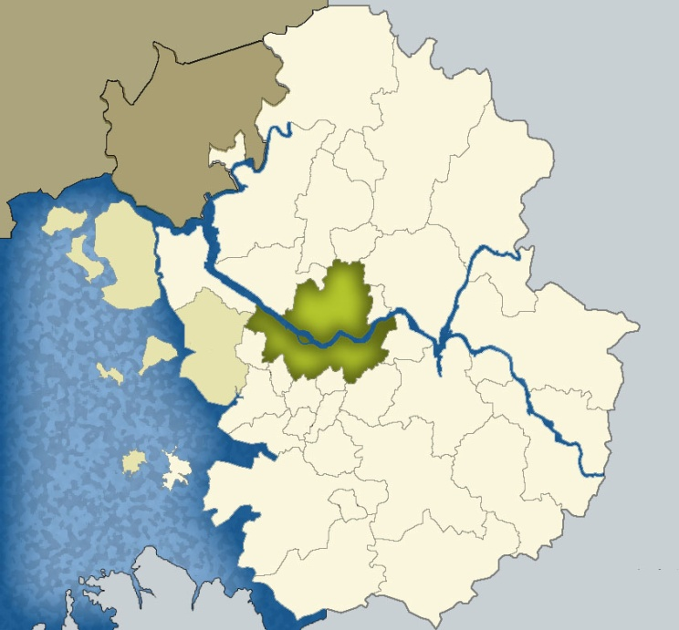
Introduction
Location of Seoul
Seoul in Asia
Seoul in South Korea
Seoul in Capital Region
North Korea
SEOUL
SEOUL
Seoul, the capital city of Korea,
is located in the middle of
the Korean Peninsula linking China and Japan, the largest consumer markets of Asia.
Notes:
서울의 위치는 한반도의 중앙부에 위치하고 있습니다.

Slide 5
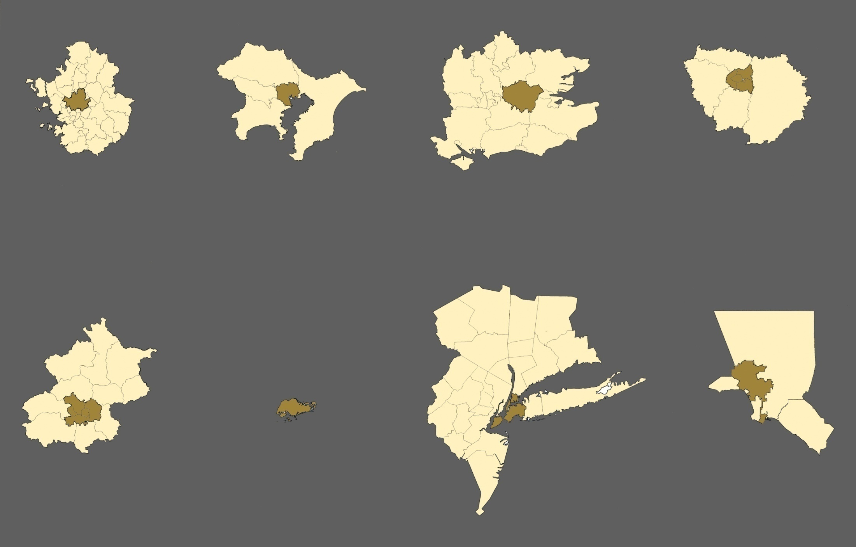
Introduction
Comparison of Major Cities
Seoul
Tokyo
London
Paris
Area Pop’n
11,730㎢ 22.7million
605㎢ 9.8 million
Area Pop’n 13,494㎢ 34.2 million
2,187㎢ 12.5 million
Area Pop’n
26,976㎢ 12million
1,578㎢ 8million
Area Pop’n
12,072㎢ 10million
762㎢ 9.6million
Metro
Seoul
Metro
Tokyo (12Ward)
Metro Greater London
Metro
Paris (Petite-Couronne)
Beijing
Singapore
New York
Los Angeles
Area Pop’n 16,808㎢ 12.1million
1,370㎢ 8.6million
Area Pop’n
693㎢ 4million
Area Pop’n
2,928㎢ 21.9million
830㎢ 8.1million
Area Pop’n
12,500㎢ 18million
1,215㎢ 3.8million
Metro
Beijing
Singapore
Metro
New York
Metro
Los Angeles
5
Notes:
서울의 면적은 605제곱킬로미터이며, 거주인구는 현재 약1,050만만명입니다.
외국의 주요 도시와 비교한 그림입니다.3

Slide 6
Introduction
Facts About Seoul
South Korea
Capital Region
Seoul
Concentration Rate(%)
(A)
(B)
(C)
B/A
C/A
Area(‘10)
(㎢)
99,646
11,730
605
11.8
0.6
Population(‘10)
(1000 pers.)
50,500
24,900
10,300
49.3
20.3
GRDP(‘05)
(billion won)
817,812
334,833
156,224
40.9
19.1
Unemployment Rate(‘05)
(%)
3.7
4.4
4.8
-
-
Companies(‘05)
Manufacture
(num.)
117,205
67,079
19,787
57.2
16.9
Service
(num.)
2,287,389
1,033,052
525,850
45.2
23.0
Employees(‘05)
Manufacture
(1000 pers.)
117,205
67,079
19,787
57.2
16.9
Service
(1000 pers.)
2,287,389
1,033,052
525,850
45.2
23.0
Academic Service(‘05)
University
(num.)
117,205
67,079
19,787
57.2
16.9
Student
(1000 pers.)
2,287,389
1,033,052
525,850
45.2
23.0
Medical Service(‘05)
Hospital (num.)
2,287,389
1,033,052
525,850
45.2
23.0
Finance(‘05)
Loan (billion won)
2,287,389
1,033,052
525,850
45.2
23.0
Notes:
이 표는 서울과 수도권의 집중도를 보여주고 있습니다.
서울과 수도권의 면적은 전국대비 0.6%, 11.8%이지만, 인구비는 20.8%, 48.2%이며, 경제, 고용, 교육 등으로 보아 상당한 집중도를 보이고 있습니다.

Slide 7
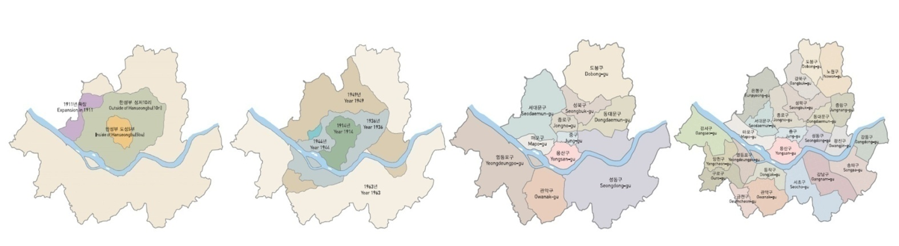
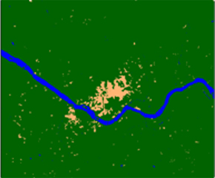
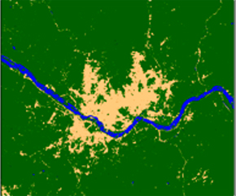
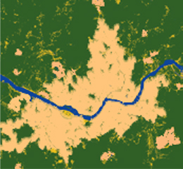
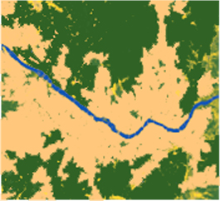
Transformation of Seoul
Introduction
1394년-1913년
1914년-1963년
1973년
2005년
Administrative district
Road system
Urban form
1936년
1966년
1972년
2000년
1957년
1972년
1988년
2005년
출처: 지도로 보는 서울 2000, 서울시정개발연구원, 2001 l 지도로 본 서울 2007, 서울시정개발연구원, 2008
Source: Thematic Maps of Seoul 2000, Seoul Development Institute, 2001 l Thematic Maps of Seoul 2007, Seoul Development Institute, 2008
Notes:
인구 및 주요 기능의 집중에 따라 서울의 행정구역(범역)도 상당히 넓어져 왔습니다.
현재는 25개 자치구로 구성되어 있으며, 거미줄 같은 도로망과 9개의 지하철망이 운영되고 있습니다.

Slide 8
Introduction
Planning System of Seoul
Metropolitan Plan
Capital Region Readjustment Plan
Sectional Metropolitan Plan
(Land Use, Transportation, Green Network, etc.)
2020 Seoul Master Plan
Sub-Regional Development Plan
Municipal Plan
Urban Management Plan
Implementation Plan
Legal Plan
Guidance
Notes:
서울 도시계획은 주변지역을 광역적으로 관리하는 광역도시계획, 도시기본계획, 도시관리계획 순으로 체계화되어 있고, 수도권만 별도로 정비와 규제차원에서 수도권정비계획이 수립되어 있습니다.

Slide 9
Introduction
Master Plan of National Land
Main Goals
- 동북아 경제를 선도하는 World City
- 서울다움이 느껴지는 Cultural City
- 자연이 되살아나는 Eco City
- 더불어 사는 Welfare City
북한·대륙경제권
금강산·설악산국제관광지
관
리
권
백
경
지
역
두
접
대
강화
문화권
서울
강원동해안권
간
환
황
해
권
민
환
동
해
권
중부내륙권
인천
국제공항
중원
문화권
족
아산만권
생
안동
문화권
History of the Plan
- 20년 목표 장기계획(5년마다 재정비)
- 제1차 국토종합계획(’72 ~ ‘81) : Growth
- 제2차 국토종합계획(‘82 ~ ‘91) : Distribution
- 제3차 국토종합계획(‘92 ~ ‘99) : Local Growth
- 제4차 국토종합계획(‘00 ~ ‘20) : International Competitiveness
태
대전청주권
백제
문화권
공
대구포항권
전주·군장권
원
신라문화권
부산경남권
광주목포권
광양만진주권
남해안 국제관광벨트
제주도
(국제자유도시)
환 태 평 양

Slide 10
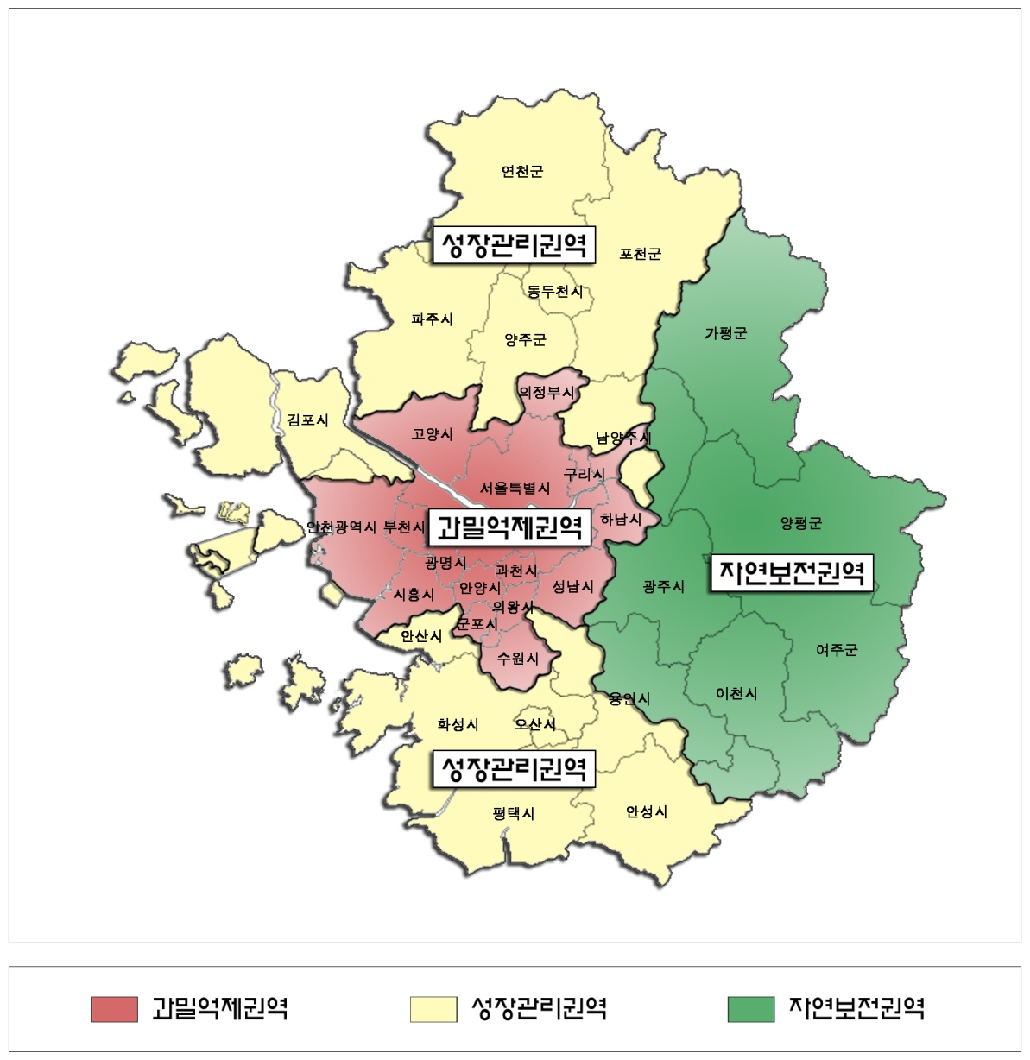
Introduction
Regulative Policy and Planning System
Over-Crowded Control Zone
Growth Management Zone
Nature Conservation Zone

Slide 11
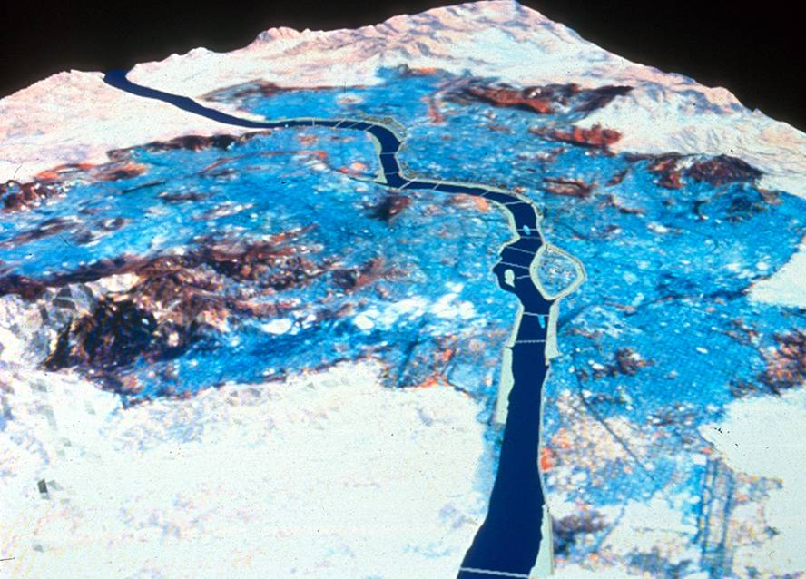
Master Plan of Seoul
Notes:
2020년을 계획목표로 하는 도시기본계획에 대하여 주요 사항을 설명드리겠습니다.

Slide 12
Master Plan of Seoul
New Paradigm for Urban Planning
‘Healing’
Urban problems
caused by city growth
GROWTH
- DRIVEN MODEL
(Quantitative Growth)
GROWTH
- MANAGEMENT MODEL
(Qualitative Growth)
‘Restoring’
the Historic, Cultural
& Natural Environments
Rapid Development
Vehicle-oriented Development
Quantitative Development
Disregard for History, Culture,
& Nature
Balanced Development
Public transit-oriented Development
Qualitative Development
Emphasis on History, Culture,
& Nature
Notes:
기본적으로 장기종합계획의 패러다임을 양적 성장에서 질적 성장관리 모델로 전환하는 것입니다.
균형발전, 대중교통, 역사문화, 환경생태, 유비쿼터스 등을 추구하는 계획입니다.

Slide 13

Master Plan of Seoul
2030 Visions & Issues
“Global Green City of Seoul ”
Global
Competitiveness
Eco-friendly
Green City
Attractions
with
History & culture
Equity &
Balanced
Development
글로벌 리더로 도약하기 위한중심기능 집적․고도화
기후변화 대응 및 녹색환경 구현
역사적 정체성 강 화 및
창의문화도시 기반 조성
특성화를 통한 지역균형발전 및 복지서비스 확대

Slide 14
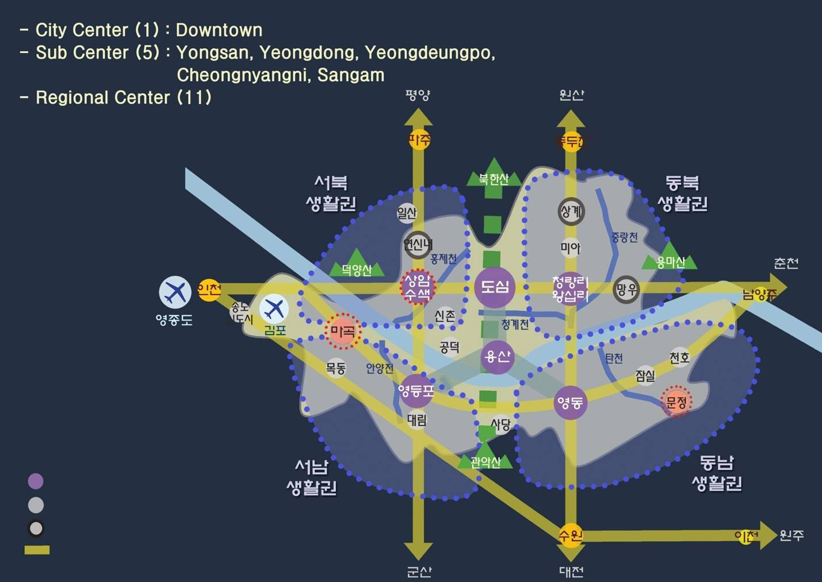
Master Plan of Seoul
Spatial Structure of Seoul for 2020
City Center / Sub Center
Regional Center
Strategic Development Zone
Development Axis
14
Notes:
이 그림은 도시공간구조를 나타내고 있습니다.

Slide 15
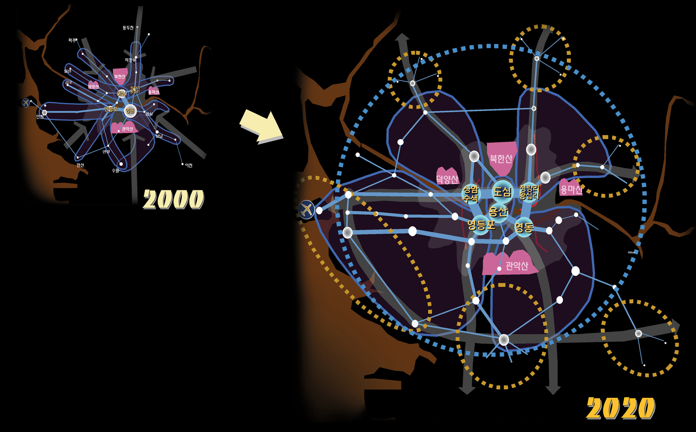
Spatial Structure Plans for 2020
Master Plan of Seoul
Toward Decentralized City with Multi-Nuclei
Notes:
서울은 도시정책의 공간적 범위를 수도권을 포함하여 광역적으로 설정하고 있습니다.
많은 사람들이 거주는 서울 외지역에서 하고, 직장은 서울에 있기 때문입니다.
그 만큼 통행량이 발생합니다.

Slide 16
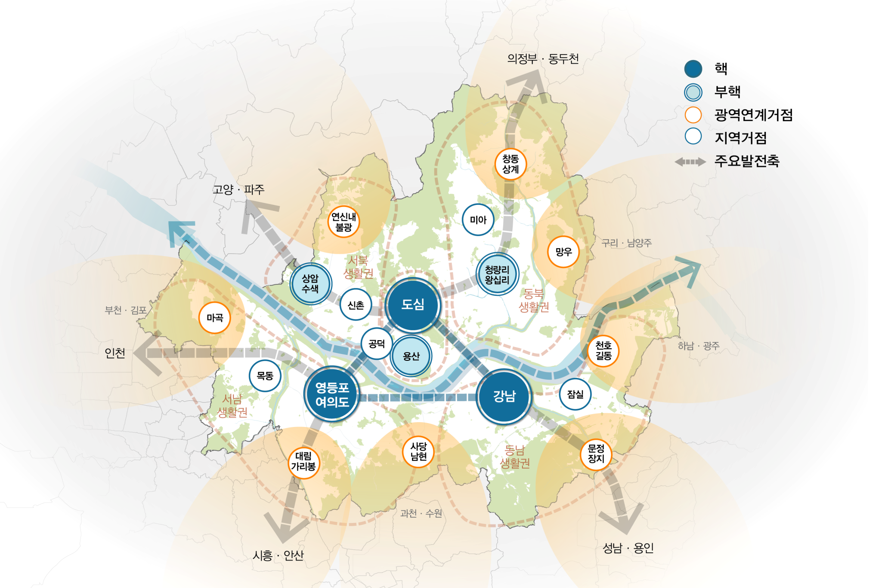
Master Plan of Seoul
2030 Revision of Spatial Structure
“Spatial Structure in connecting with Multi-Centers”

Slide 17
Master Plan of Seoul
2030 Revision of Spatial Structure
“Spatial Structure in connection with Multi-Centers”
1. Strengthening functions of urban centers
2. Characterizing regional development issues &
potentialities
3. Land using in view of TOD around stationary zone
4. United management of traffic-infrastructure in
metropolitan level

Slide 18
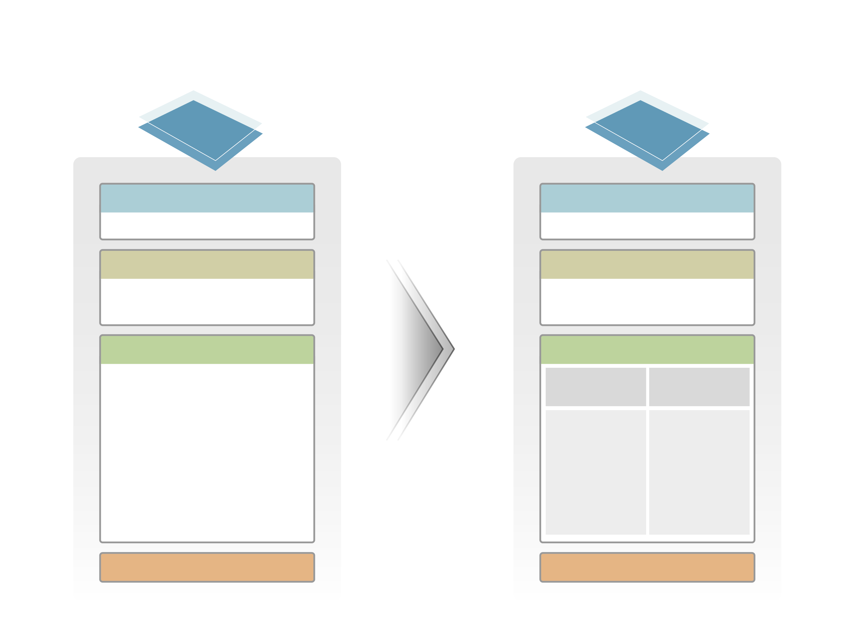
Master Plan of Seoul
Comparison of Spatial Structure
2020
2030
1도심
3핵
도심
도심 / 영등포·여의도 / 강남
5부도심
3부핵
영등포 / 영동 /
용산 / 청량리·왕십리 / 상암·수색
용산 / 청량리·왕십리 / 상암·수색
11지역중심
13거점
8 광역연계거점
5 지역거점
망우 / 상계 / 미아 / 연신내 /
신촌 / 공덕 / 목동 /
대림 / 사당·남현 / 잠실 /
천호·길동
망우 / 창동·상계/
연신내·불광 /
마곡/ 대림·가리봉/
사당·남현 /
문정·장지 /
천호·길동
미아 / 신촌 /
공덕 / 목동 / 잠실 /
※ 전략육성지 : 마곡 / 문정
전략육성중심지 : 상계 / 연신내 / 망우
53지구중심
50지구중심

Slide 19
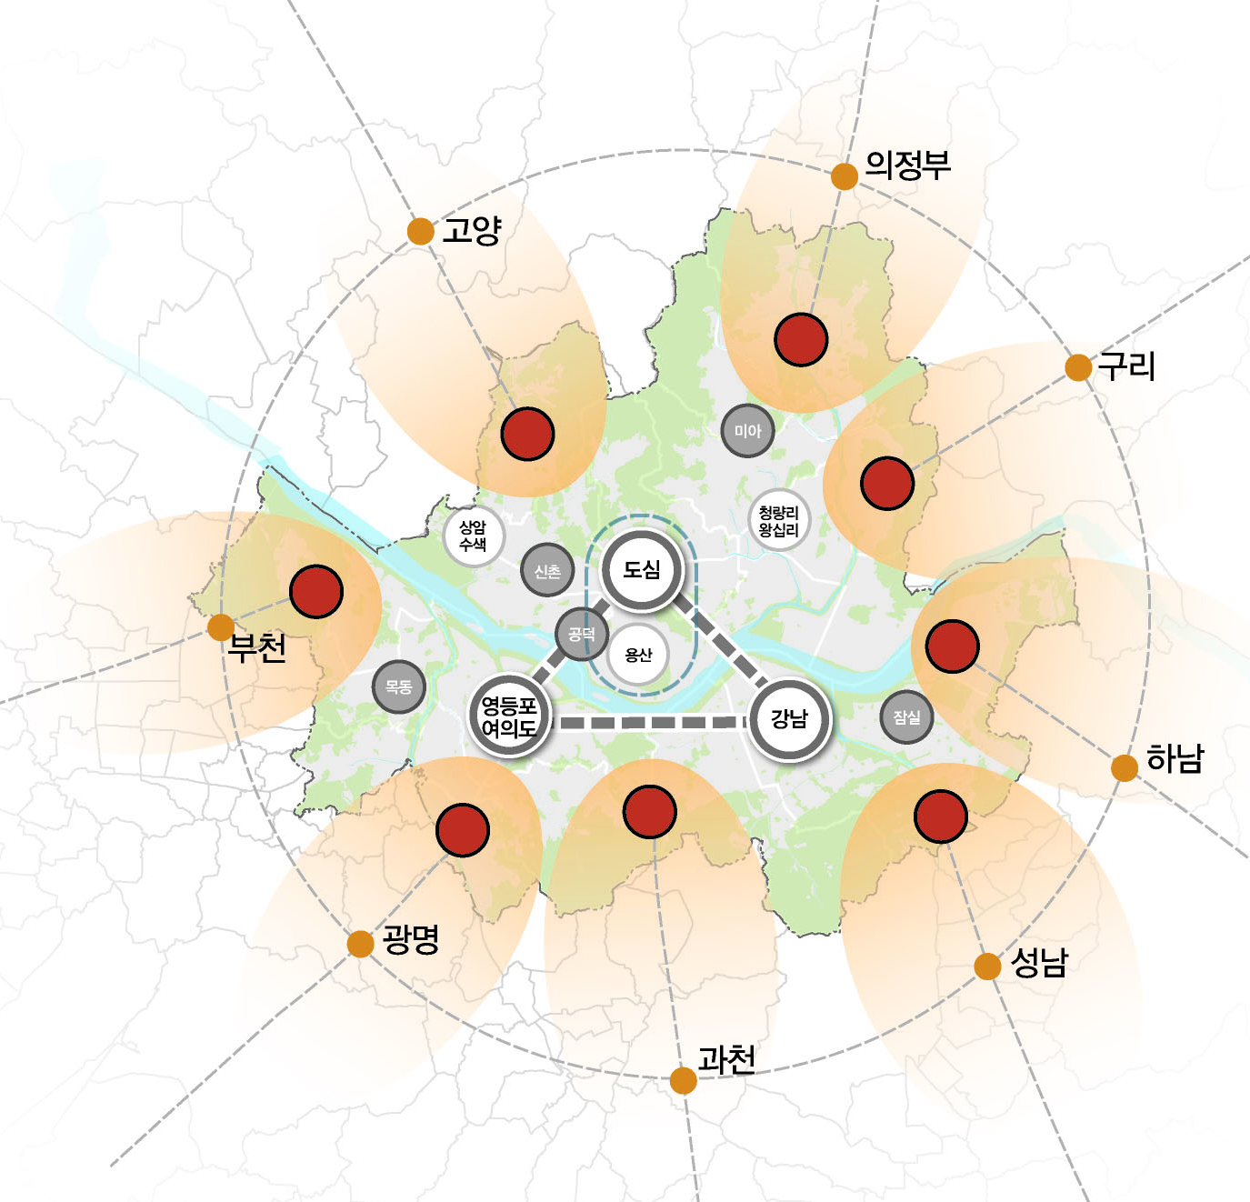
Master Plan of Seoul
Characterizing Territorial Functions
2030 Revision
3center·3sub-center
Special basis for national & regional economy
- international finance, bank, organization, global business
Urban Centers for management and commerce
Metro point center
Functional linkage with new town & satellite city in SMR(Capital Region)
- public transportation(bus, subway)
Regional point center
Expanding the space and service for commercial functions to support metro-community

Slide 20
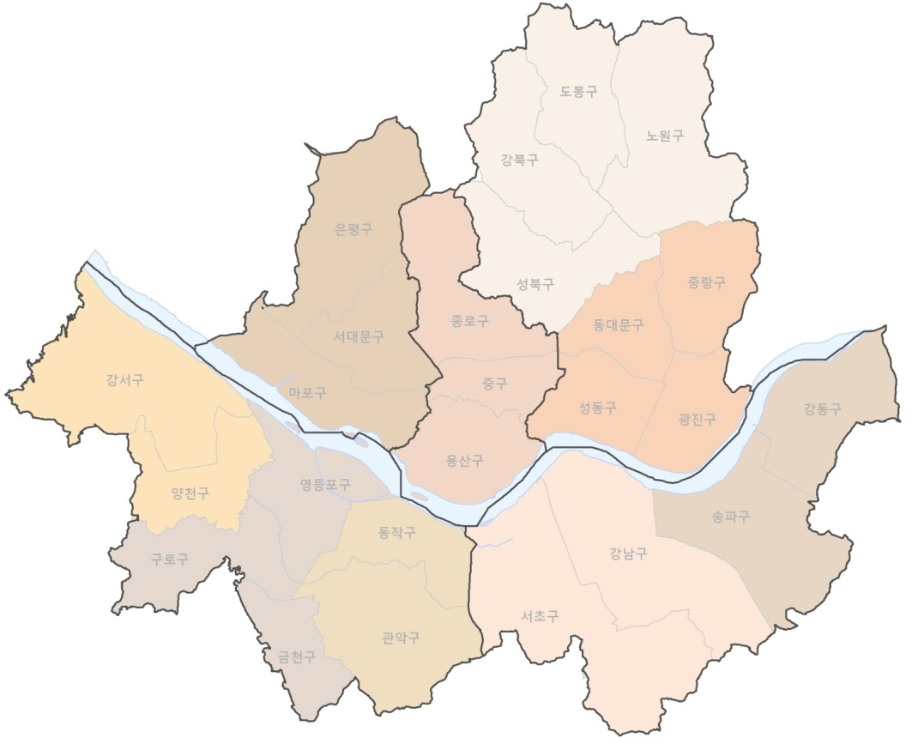
Master Plan of Seoul
The Development Issues of 5 Regions
2030 Revision
Northwest
Northeast
Cultural & media industries
Eco-friendly community
Fostering new-economic center
Efficient utilization and environmental development of waterfront
CBD
Identity of historic city
Global competitiveness
Southwest
Southeast
High-tech manufactures
Comfortable living condition
Strengthening global functions based on knowledge industries
Growth management of urbanized area

Slide 21
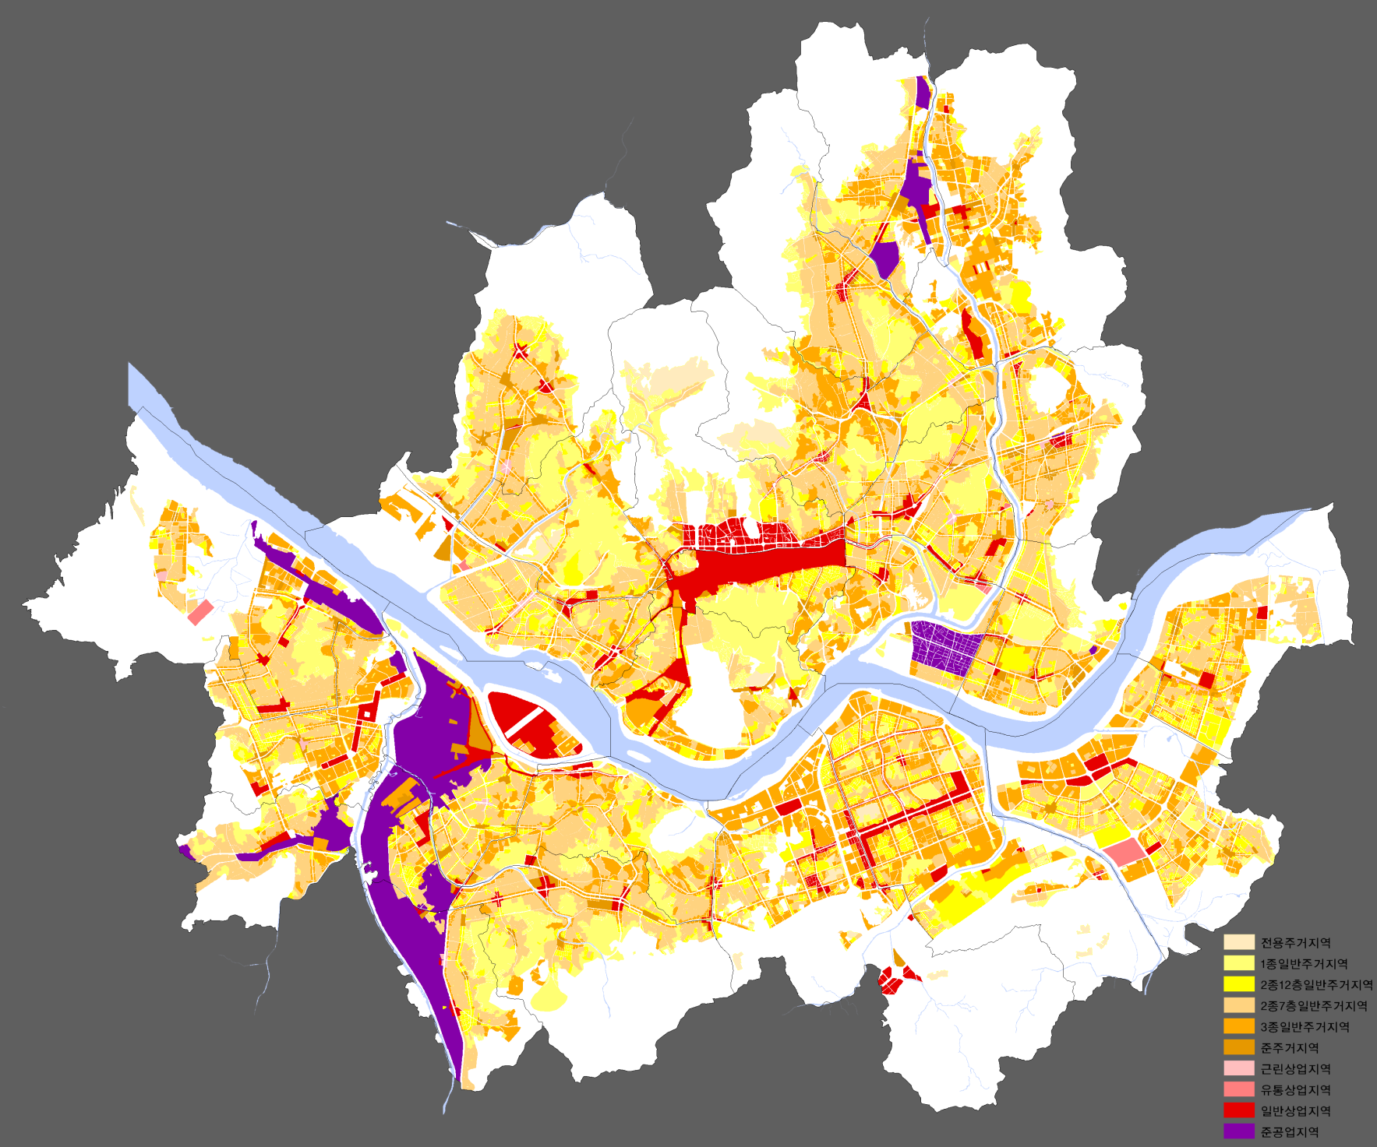
Zoning System of Seoul
Master Plan of Seoul
Zone | Area (㎢) | Proportion (%)
Residential | 316.69 | 52
Commercial | 23.56 | 4
Industrial | 20.00 | 3
Green | 246.03 | 41
Total | 606.55 | 100
Exclusive Residential District
No.1 Category General Residential District
No.2 Category General Residential District
(Below 12 floor)
No.2 Category General Residential District
(Below 7 floor)
No.3 Category General Residential District
Semi-Residential District
Neighborhood Commercial District
Distribution Commercial District
General Commercial Dstrict
Semi-Industrial District
Source : Seoul Development Institute, 2007
21
Notes:
서울의 토지이용을 조닝으로 구분한 것입니다.
노란색인 주거지역 52%, 빨강색인 상업지역이 4%, 보라색인 준공업지역이 3%, 그리고 외곽에 녹지지역이 41%입니다.
용도지역에 따라 건축기준, 즉 건축물의 용도, 건폐율, 용적률, 높이 등을 달리 적용하고 있습니다.

Slide 22
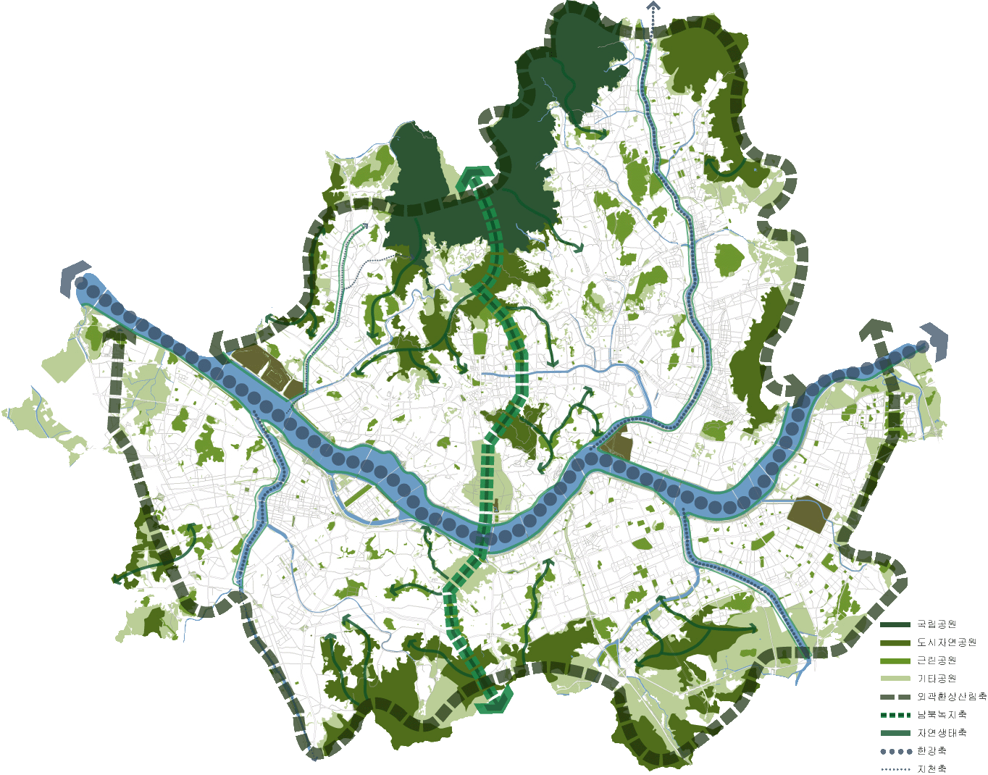
Master Plan of Seoul
Linkage of Green Spaces
Jungrangcheon
Worldcup
Park
Sewoon
District
Cheonggyecheon
Hongjecheon
Seoul
forest
Yeouido
Park
Yongsan
Park
Anyangcheon
Olympic
Park
Boramae
Park
Tancheon
Seoripool
Park
Green Ring
N-S Green Axis
Eco Axis
Water Axis
Regional Park
Source : The Master Plan of Seoul Toward 2020, 2006, Seoul
22
Notes:
서울은 동서축으로 한강이 흐르고 있으며, 남북축 및 외곽 환상형으로 산과 구릉으로 연결되는 녹지가 형성되어 있습니다.

Slide 23
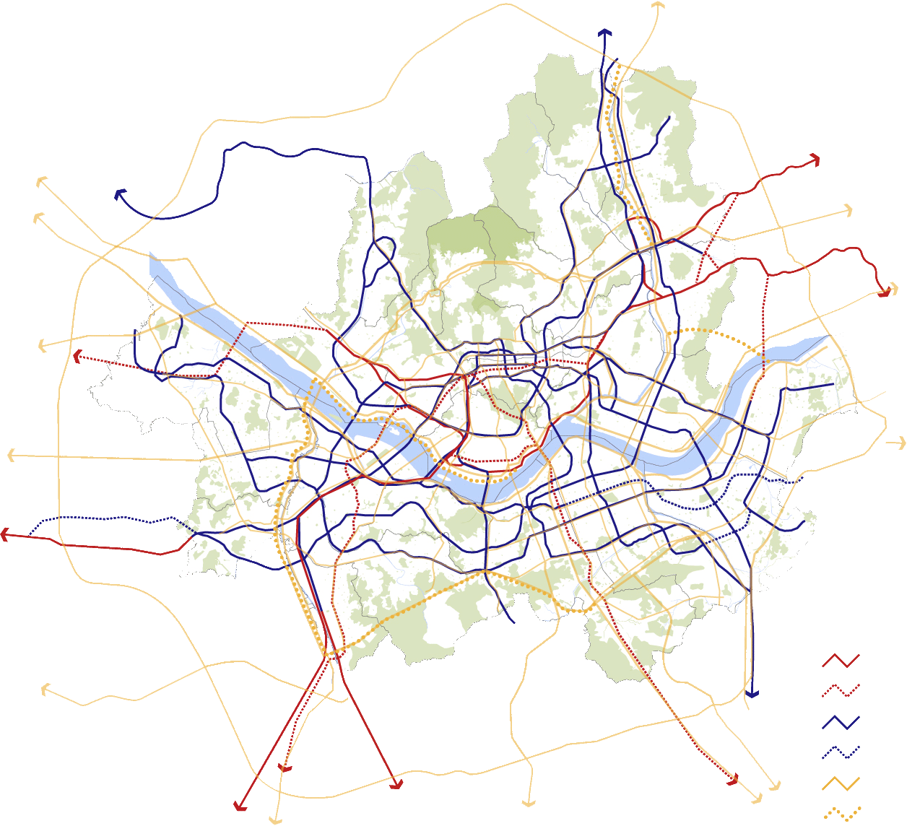
Master Plan of Seoul
Transportation Network
Wonsan
Uijeongbu
Munsan
ChunCheon
Gimpo
Namyangju
Guri
Incheon
Wonju
Incheon International Airport
Incheon
Gwangju
Incheon
Siheung
Railroad
Railroad(plan)
Subway
Subway(plan)
Main Road
Main Road(Plan)
Bundang
Ansan
Bundang
23
Cheonan
Daejeon
Suwon
Source : Seoul Development Institute, 2007
Anyang
Seongnam
Notes:
서울의 교통망은 지하철 9개 노선과 내부순환도로, 한강변으로 올림픽대로, 월드컵대로와 주요 간선망이 연결되어 있으며, 시외의 지역간을 연결하는 외곽순환도로가 건설되어 있습니다.

Slide 24
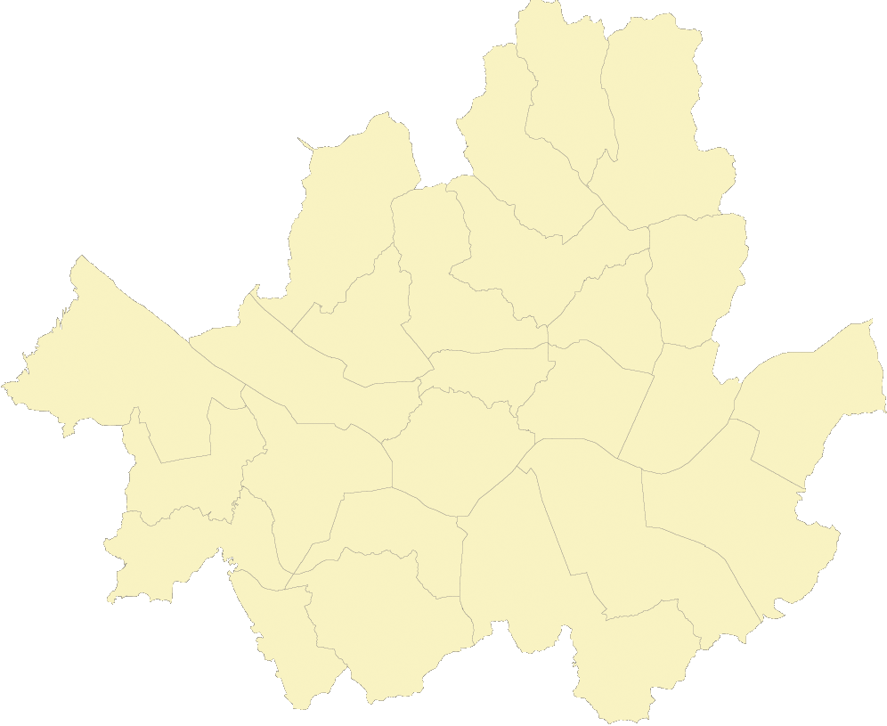
Master Plan of Seoul
Plans of Culture Development
Ecology culture /
Unified Korea culture & arts
Hangang(river)
ecology belt
CBD
(making historical
& cultural space)
International
culture & arts
Sangam
Zone of International culture
Jamsil
Sports/
leisure zone
Public culture & arts
Yeouido
Zone of Citizen’s culture
Ttukseom
Ecology zone
Modern culture & arts
24
Notes:
최근에는 문화기능의 지역별 특성화를 유도하고 있습니다.

Slide 25
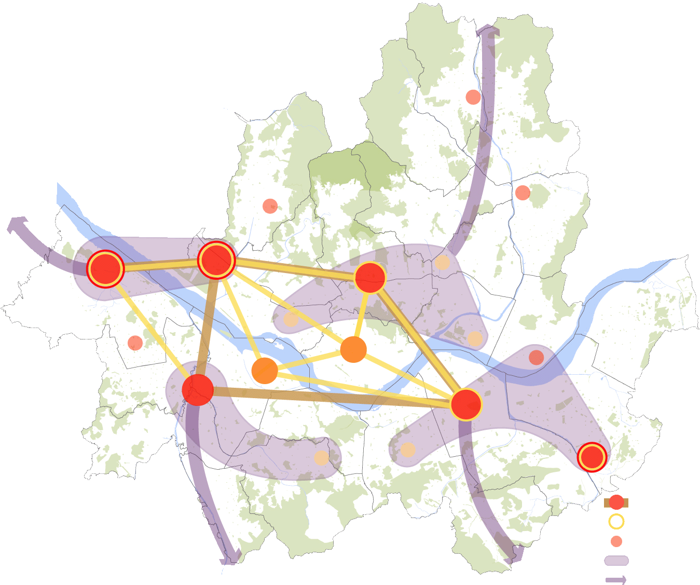

Master Plan of Seoul
Agglomeration of Industrial Cluster
Hongneung-Uijeongbu Axis
(Research-based Start-up Company)
Sanggye
Yeonsinnae
Mangu
Gimpo/Songdo-Yeongjongdo Axis
(International Business)
High-tech Industry
International Finance
Dongdaemun
Magok
Sangam
City Center
Media/Environment
Digitization of Old Industry
Sinchon
Mokdong
Yongsan
Seongdong
Yeouido
GwangJin
Guro
Geumcheon
International
Business
International
finance
Gangnam
Trade/High-tech
IT/ Manufacture
Gwanak
Seocho
Munjeong
4 Strategic Posts of Digital Industry
Diamond of International Business
Strategic Posts for Balanced Regional Development
Industrial Green-line
Industrial Belt of Capital Region
Bucheon/Anyang Axis
(IT/Manufacture)
Bundang/Pangyo-Yongin Axis
(S/W, IT Service)
Source : The Master Plan of Seoul Toward 2020, 2006, Seoul
25
Notes:
산업 클러스터 역시 공간별로 집적경제를 유도하기 위한 특성화 전략과 공간적 연계체계를 구축하고 있습니다.

Slide 26
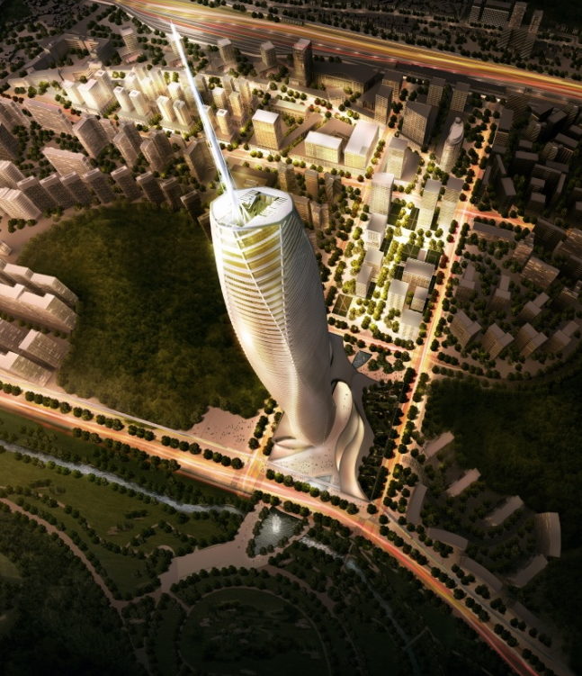
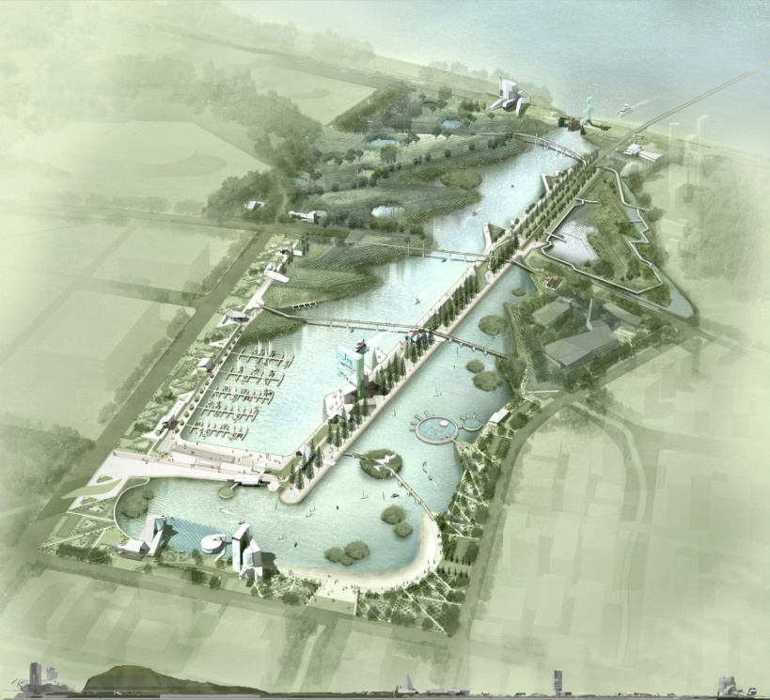
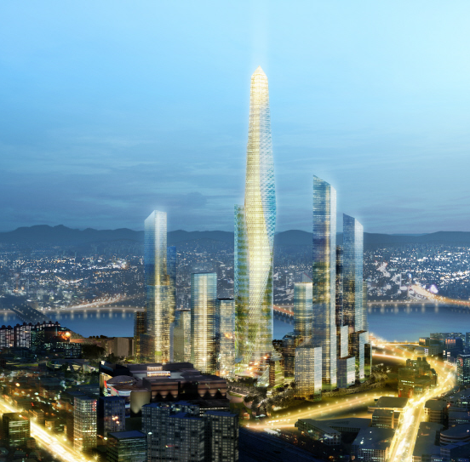
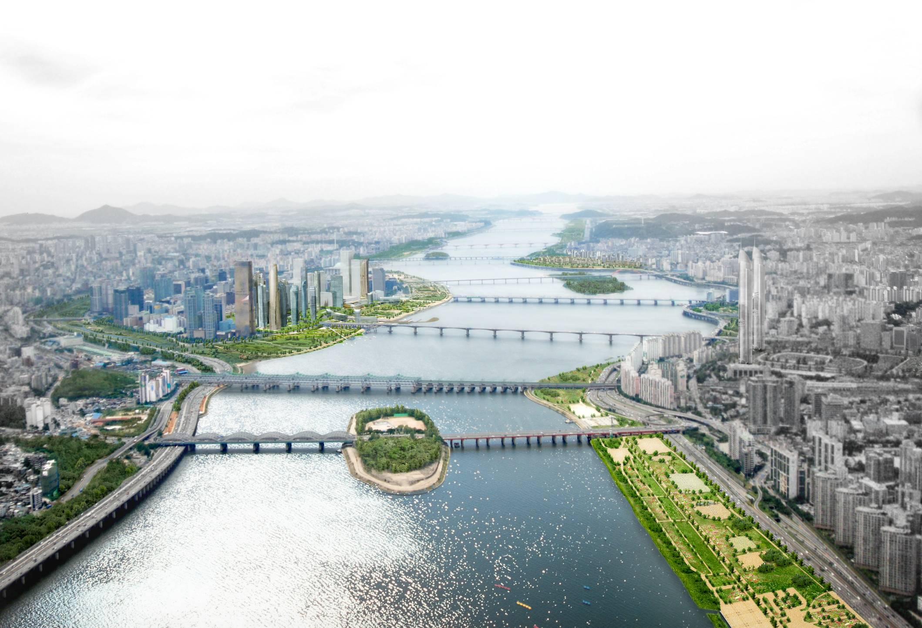
Main Projects
Notes:
주요 도시정책입니다.

Slide 27
Urban Renaissance for Downtown Seoul
Notes:
도심재창조입니다.

Slide 28
Urban Renaissance for
Downtown Seoul
Vision and Goals
A Vision of Downtown Seoul
To be a competitive international center with a 600-year long history as well as a vital culture hub of global Seoul
Goals of Downtown Regeneration
International Competitiveness
Promotion of the design & fashion industry and international business as the new growth engine
Tourist Attractions
Development into a tourist city, full of fascination and vitality
Sustainability with Environment and Landscape
Restoration of north-south green network as an environment and landscape city
Historic Preservation
Continual restoration of a 600-year-long history and cultural heritage
Leading the World as a Ubiquitous City
Establishment of a ubiquitous infrastructure utilizing Korea’s advanced IT
28
Notes:
도심재창조 프로젝트의 목표는 역사문화도시 서울 도심부의 공간구조, 기능을 재편함으로써 국제경쟁력과 지속가능성을 증진시키는 것입니다.

Slide 29
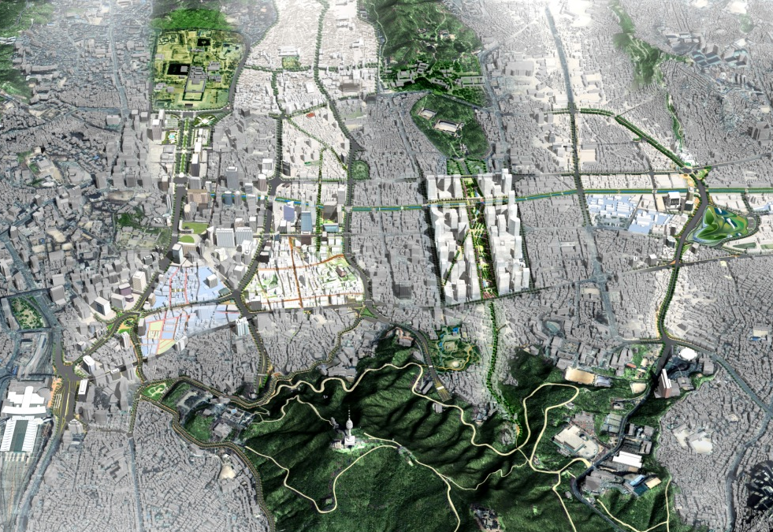
Urban Renaissance for
Downtown Seoul
Four North-South Axes and Mt. Namsan
1 Axis : Historic Corridor
2 Axis : Digital Media Corridor
3 Axis : Green Corridor
4 Axis : Creative Corridor
2축
관광문화축
Digital Media Corridor
29
Notes:
도심재창조 프로젝트는 4개의 축으로 구성되어 있습니다.
1축은 역사문화축, 2축은 관광문화축, 3축은 녹지문화축, 4축은 복합문화축입니다.

Slide 30
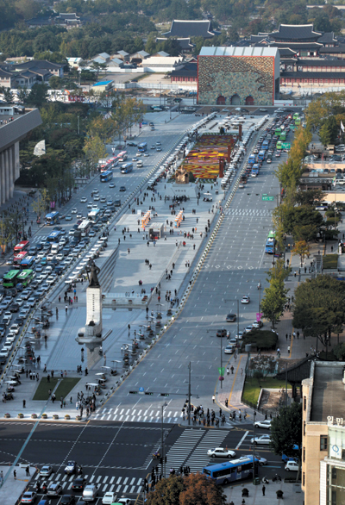
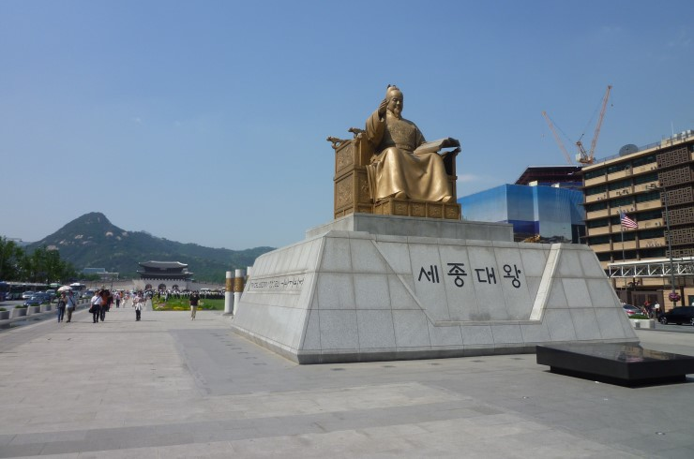
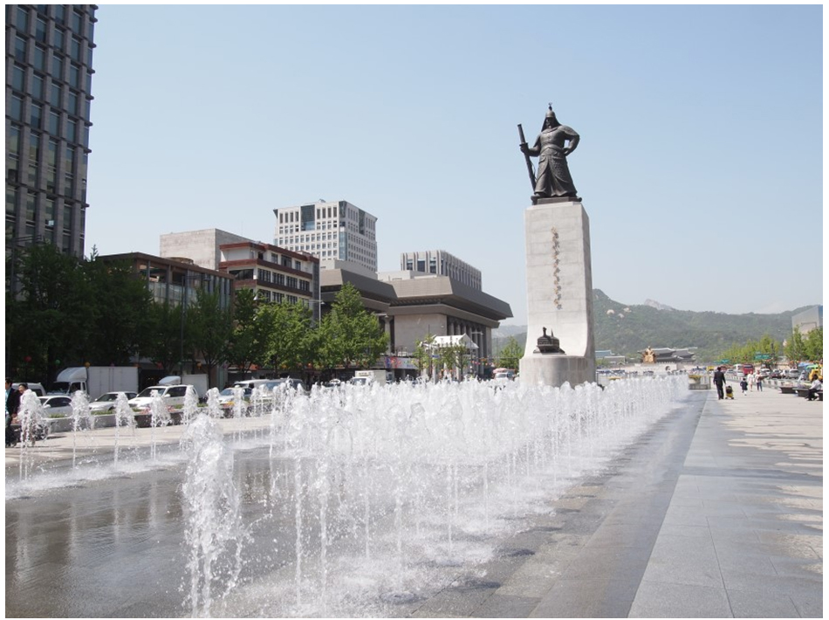
Urban Renaissance for
Downtown Seoul
광화문광장(National Symbolic Square)
30

Slide 31
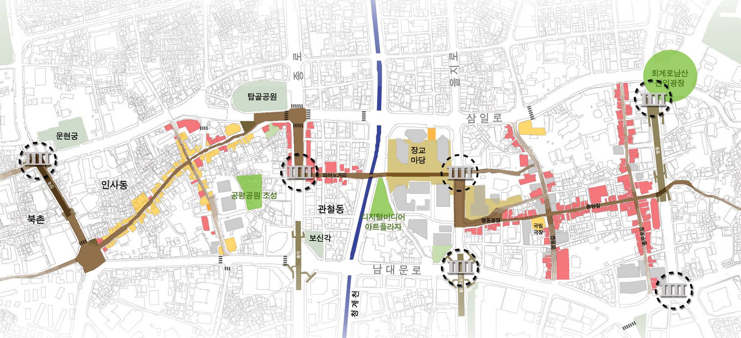
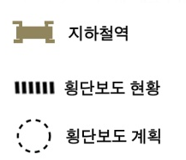

Urban Renaissance for
Downtown Seoul
Accessible & Comfortable Pedestrian Network
Subway Station
Main Street
Pedestrian walkway
(Existing : Whole day)
Crosswalk (Existing)
Improvement of the privately owned space
Pedestrian walkway
(Expansion to whole day)
Crosswalk (Plan)
Public park and plaza
Pedestrian walkway
(New designation)
Scope of project
Pedestrian network between main landmarks
and improve the quality of the street environment
- Create crosswalks and parks
- Improve the environment of important pedestrian streets
· Maximize the ripple effect of the urban vitality through increasing
interconnectivity in downtown
· Pedestrian friendly environment through street improvement projects
creating pedestrian walkways and crosswalks
31

Slide 32
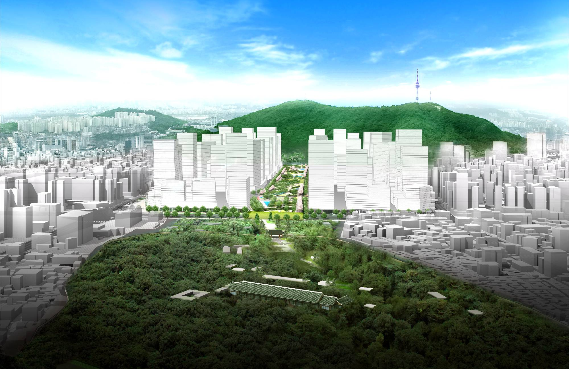
Urban Renaissance for
Downtown Seoul
Green Axis at Sewoon District
Image of Sewoon Redevelopment
32
Notes:
완성되었을 때의 조감도 입니다.

Slide 33
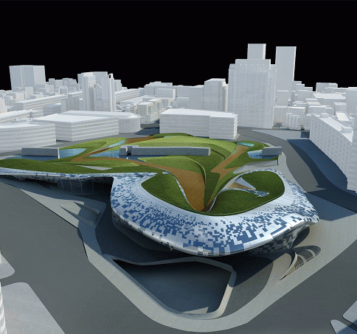
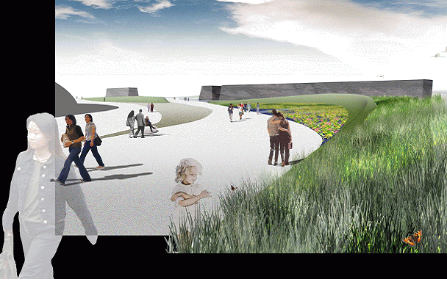
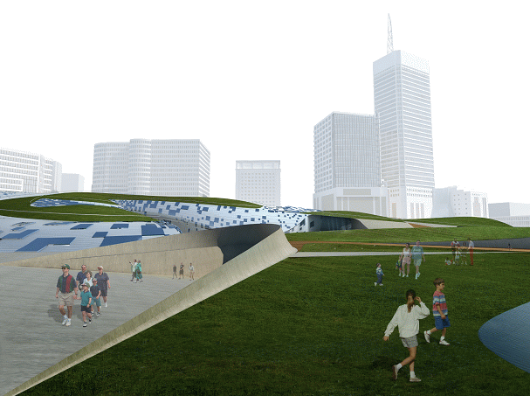
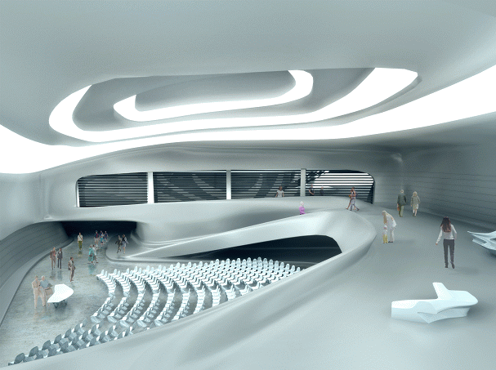
Urban Renaissance for
Downtown Seoul
Dongdaemun World Design Park & Complex
`Motonymic Landscape’ by Zaha Hadid
33
Notes:
조감도입니다.

Slide 34
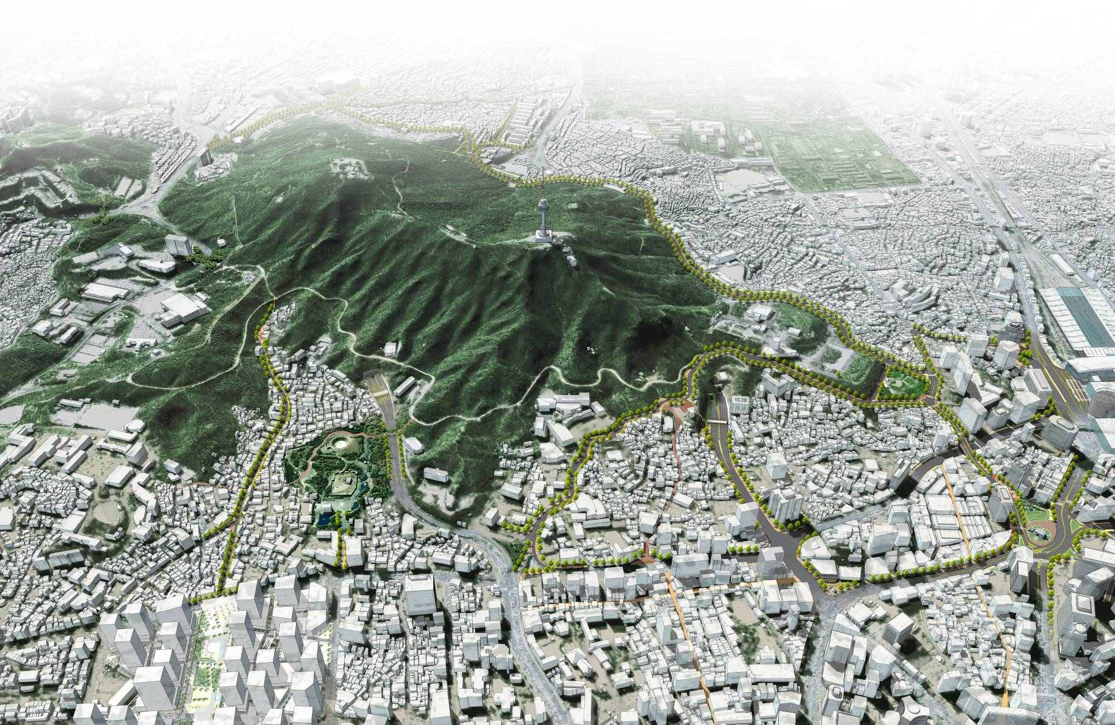
Urban Renaissance for
Downtown Seoul
Accessible Namsan
Pedestrian Network
Creation of Pedestrian Access Routes
to Mt. Namsan from Downtown and the Han River
Four
N-S Axes
Namsan
Seoul
N Tower
Old
Castle Wall
Yongsan
Han River
Creation of environmentally friendly pedestrian access routes to Mt. Namsan (9 routes)
Recovery of potential resources and improvement of old facilities in Namsan
Seeking balance between conservation of natural environment and people’s activities
Pedestrian Network
Pedestrian Network
⇒ Eight Pedestrian Access Routes and Improvement of Pedestrian Environment
Dongguk
University
Huamdong
Pildong
Namsandong
Namdaumun Market
Myungdong
34
Notes:
도심부 중심부에 위치한 남산에 대하여 접근성과 경관을 개선하는 열린 남산 르네상스를 계획하고 실행하고 있습니다.

Slide 35
(
Han River Waterfront Development
Notes:
35
35
한강 르네상스입니다.

Slide 36
Visions and Goals
Visions of Downtown Seoul
Restoration
Repair the severed relationship between human with nature
and reconnect with the surrounding natural environment.
Creation
Discover the hidden potential of the Han River
and create a new icon of Seoul
Goals of Hangang Renaissance Project
Restructuring the related plan around Hangang
Developing waterfront towns
Making urban scape along the River
Constructing waterway in connections with the Yellow Sea
Linking eco-network around Hangang
Enhancing accessibility to Hangang
Connecting between historic sites along the River
Making riverfront theme park
Notes:
한강은 서울이 가지고 있는 최고의 자연자원이자 경제, 관광 기반입니다.
도시재생과 창조도시의 관점에서 한강의 환경생태를 복원하고 수변지역의 발전을 추진하며, 국제간 연결 구상을 가지고 있습니다

Slide 37
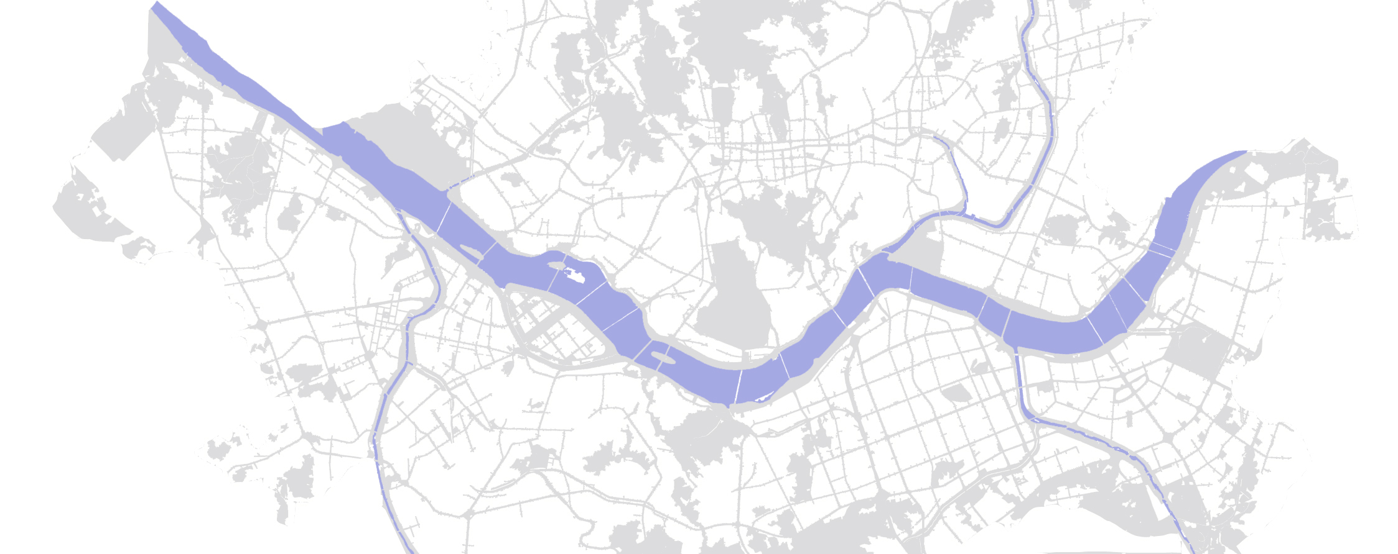
Strategic Development of the Riverside
Reinforcing the current urban center towards the Han River, expanding the city center through the connection of six major waterfront districts along the river.
Samgam Subcenter
Magok Strategic Center
Urban Center
Cheongyangni · Wangsimni Subcenter
Sangam DMC
Magok Waterfront Town
Yongsan Subcenter
Heangdang City Development District
International Finance Area
International Business Area
Sports Complex, Seoul Medical Area
Yeongdeungpo Subcenter
Yeongdong Subcenter
Notes:
한강변 주요 발전거점을 중심으로 집중적 개발을 추진합니다.(용산, 마곡, 상암, 여의도 등등)

Slide 38
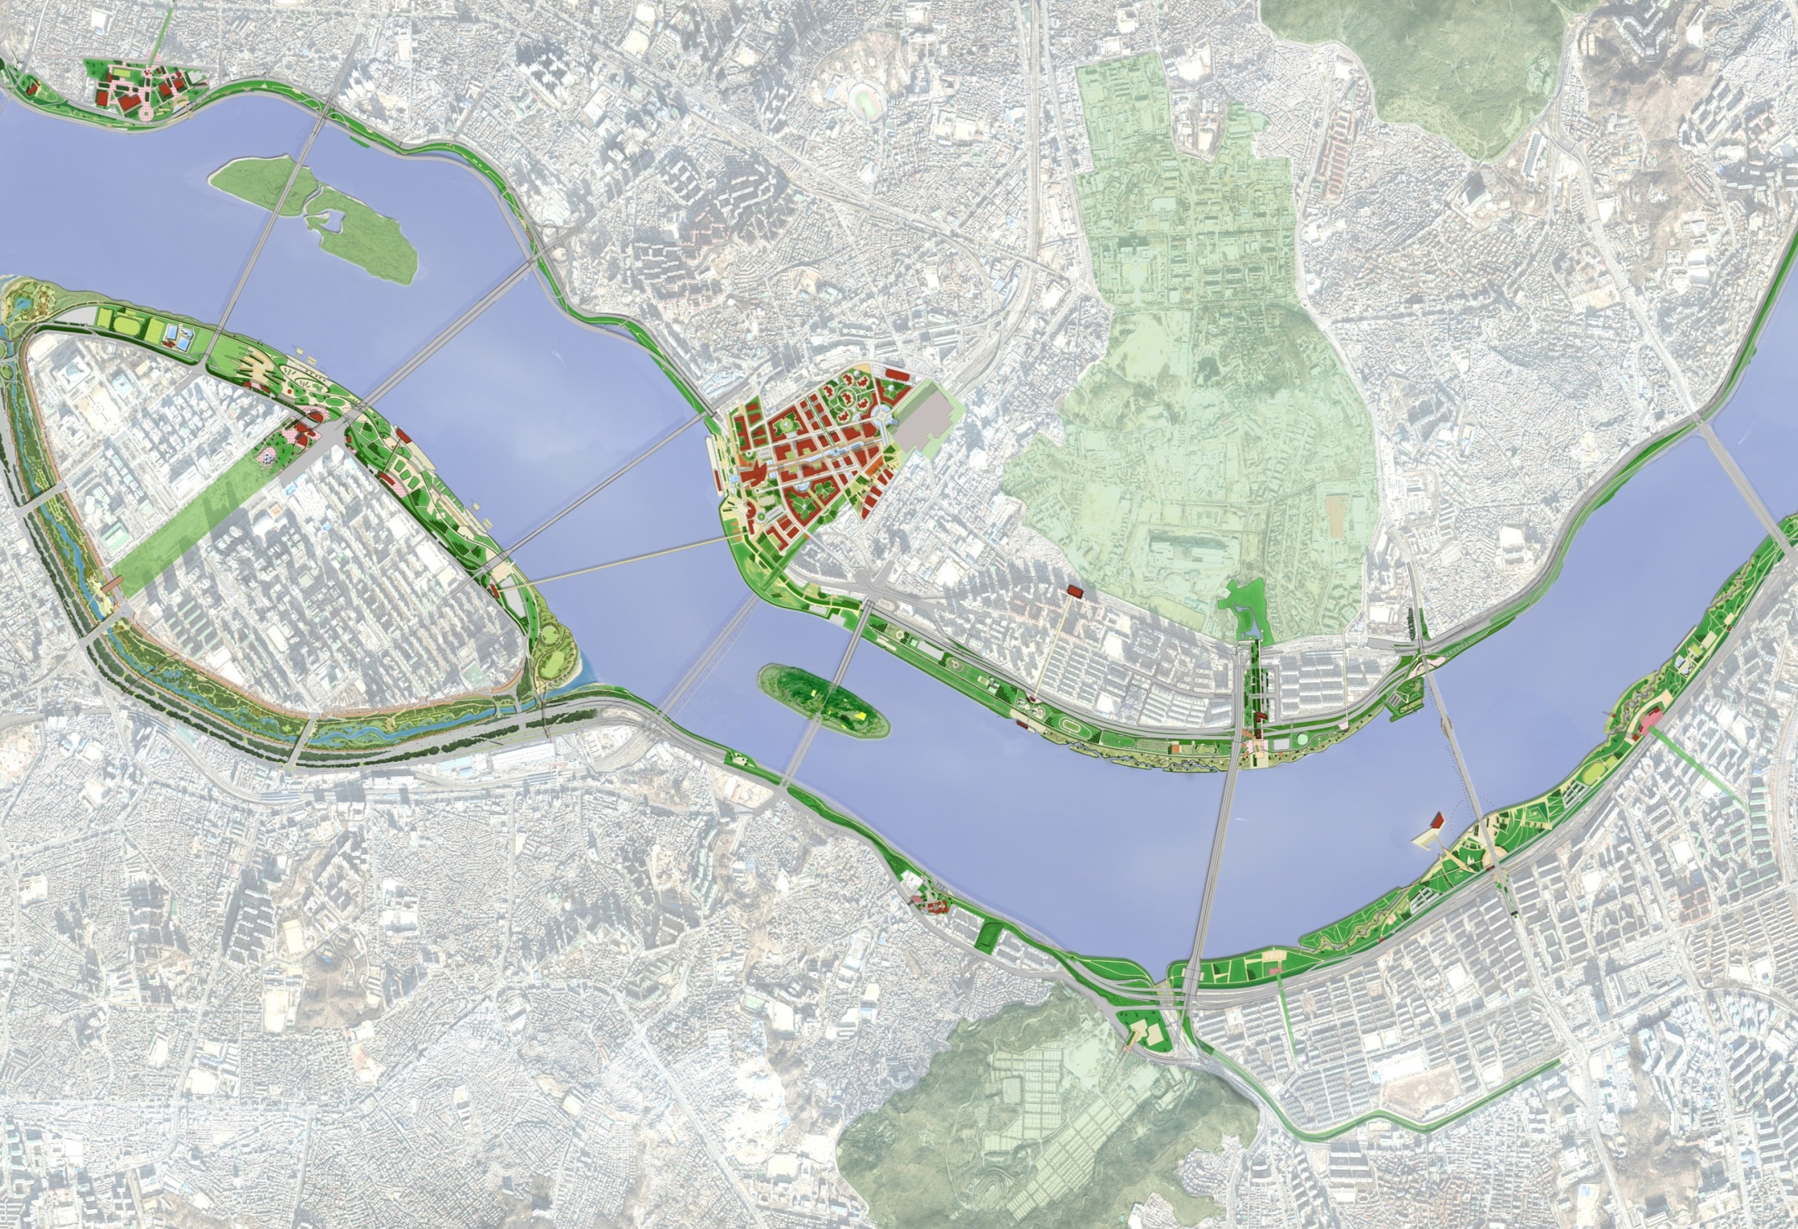
Master Plan of Urban Core
‘Business and Cultural Center that Represents Seoul’
Bamseon
Mapo Bridge
Extend Pedestrian road
Seogang Bridge
Mapo Bridge
Hangang Yongsan Park
Hannam Bridge
Extend Pedestrian road
Hangang Yeouido Park
Ferry Terminal
Yongsan Park
Ferry Terminal
Wonhyo Bridge
Yongsan International Business Area
Hannam Bridge
Yeouido Park
Monorail
Yeouido Seatgang
Yeouido CBD Area
Hangang Iron Bridge
Hangang Ichon Park
Jamsugyo change ro Pedestrian road
Nodeulseom
Hangang Bridge
Dongjak Bridge
Extend Pedestrian road
Banpo Bridge
Hangang Bridge
Extend Pedestrian road
Hangang Jamwon Park
Dongjak Bridge
Core of Seoul’s business center
Core of cultural center in Nodeulseum
Hangang Banpo Park
Strengthen connections with the surrounding areas
Towards the hub of the West Sea waterway network
International Memorial Park
38
Notes:
38
38
한강변 주요 지점에 대한 개발방향입니다.

Slide 39
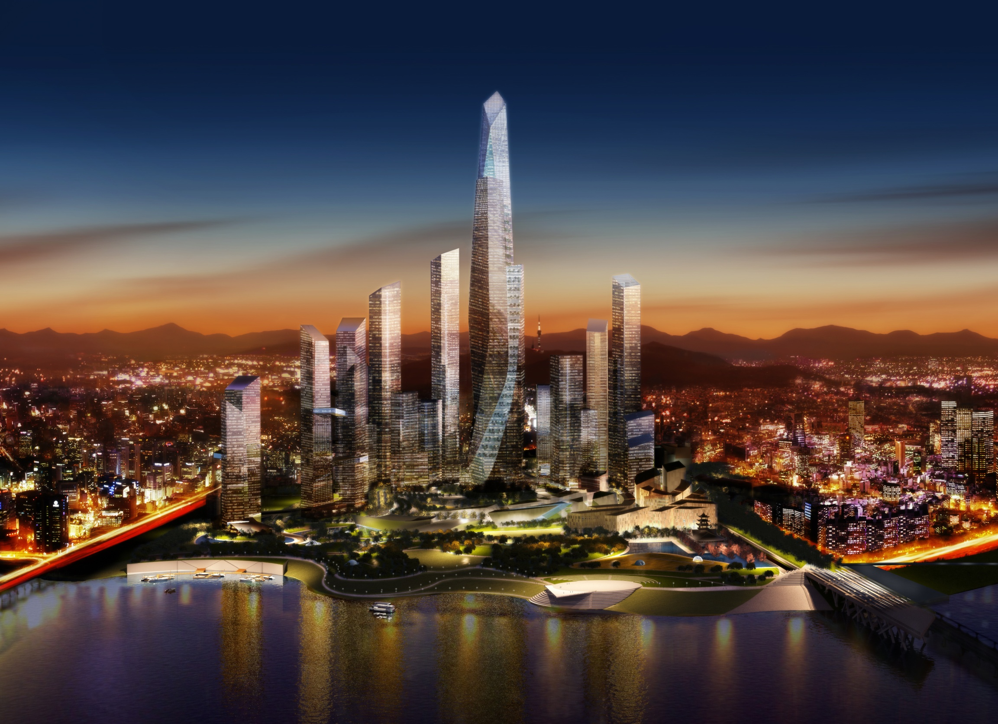
Development of Yongsan Area
Notes:
39
39
용산 지역의 국제업무지구 개발계획입니다.

Slide 40
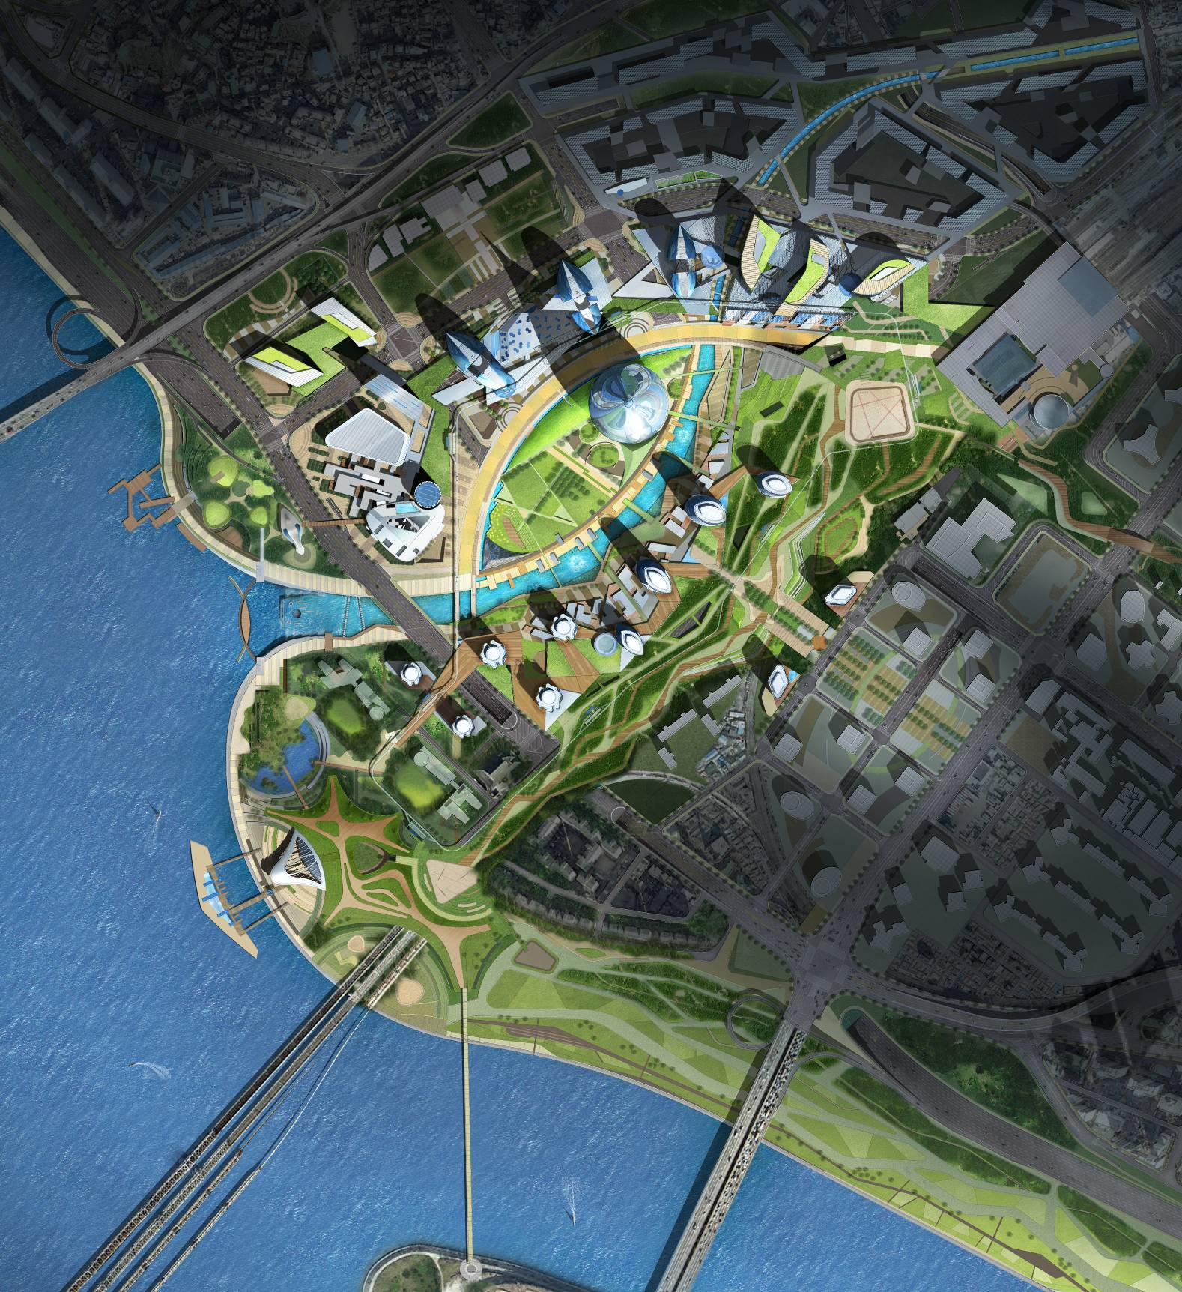
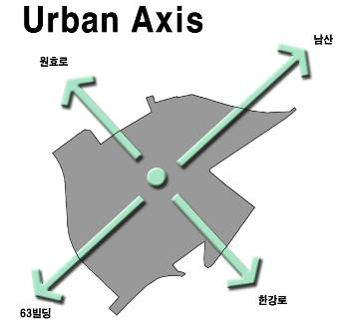
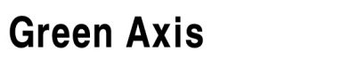

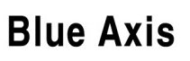
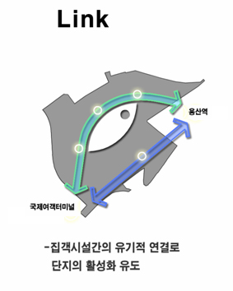


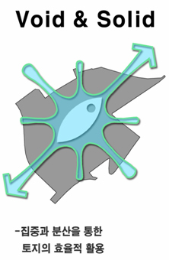

Development of Yongsan Area
Yongsan International Business District
Total Floor Area : 3,192,679㎡
Total Floor Area Ratio : 608%
Wonhyoro
Namsan
Yongsan
National Park
63Building
Hangangro
Hangang Civic Park
Creation of view corridor
Railway Deck Park, Hangang
Citizens Park, etc.
City
St. Yongsan
Assimilation
Nature
Int’l Ferry Terminal
Assimilation of the
Hangang Renaissance Plan
Wonhyoro
Namsan
Hangangro
63Building
Symbolic connection with
the urban center
Effective land use in harmony
with surrounding facilities
Notes:
용산 국제업무지구에는 100층이 넘는 초고층빌딩이 건축되고 국제, 상업, 문화, 주거가 복합된 초현대식 국제도시가 조성될 것입니다.

Slide 41
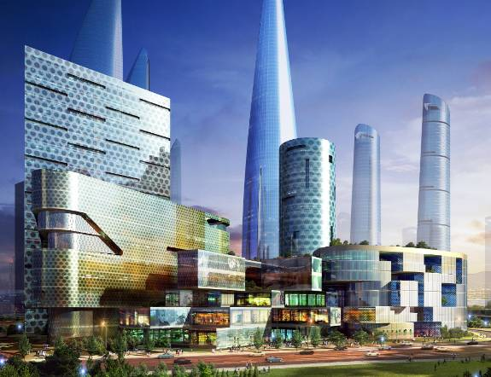


Business Sector
Development of Yongsan Area
Dream Tower : the flagship icon of the International Business District
Placement of hotels & condos with stunning river views
Hotel Condo
41
Convention

Slide 42


Housing Sector
Development of Yongsan Area
Placement of park adjacent to the river
Placement of rental housing residences near Yongsan Station & Hangang Road with views of the park & river
42
Apartment

Slide 43



Commercial Sector
Development of Yongsan Area
Low-level areas dedicated to commercial use
Connection of new commercial areas to Yongsan electronics area
Installation of Sunken Atrium
Luxury Mall
43
Digital Plaza

Slide 44



Cultural Sector
Development of Yongsan Area
Implementation of the Hangang Cultural District
Connection of the Nodeul Island Opera House with the National Museum
Int’l Ferry Terminal
44
Outdoor Performing Place

Slide 45

Development of Yongsan Area
45

Slide 46
Development of Yongsan Area
Yongsan Park
Goals of Yongsan Park
Sustainable Development
Contextual Development
Site-Specific Development
Implementation Strategies
Design of Yongsan Park
Communication, coordination, and cooperation with central government
Implementation Measures
Establishment of the vision & direction of the Yongsan Park implementation process
Decisions based on the government’s stance
Establishment of the development direction for park’s surrounding areas
Notes:
현재의 미군이 사용하고 있는 부지는 민족공원으로 조성될 계획입니다.

Slide 47




Development of Yongsan Area
W-E ecological axis and N-S green axis
West-East Ecological Green Axis
Restoring the artificial river bank to
a natural river bank
Mt. Bukhan
Mt. Bukak
Mt. Acha
Mt. Yongma
Green Central Axis
Mt. Deokyang
Forming six vertical green axes that connect
Mt. Samgak-Mt. Baekak-Mt.Namsan
with Memorial Park-Mt. Gwanak
Creating a green pedestrian path linking
Yongsan Park with Hangang Ichon Park
Mt. Gaehwa
Namsan
Yongsan
Mt. Cheong-ryang
River West Green Axis
Memorial Park
River East Green Axis
Mt. Gwanak
Green Ring
Central Green Axis (Ichon)
West side : Connect Mt. Gaehwa with
Mt. Deokyang and expand River
West wetland park
East side : Connect Mt. Acha with
Mt. Cheongryang and create Amsa Terrace
ecological park
47
Notes:
47
한강의 동서 수경녹지축과 남북의 육경축을 연결하는 그린웨이 시스템을 구축합니다.

Slide 48


Development of Yongsan Area
Park Scale Comparison
YONGSAN (267ha)
BOIS DE VINCENNES, PARIS (995ha)
(267ha)
BOIS DE BOULOGNE, PARIS (865ha)
TIERGATEN, BERLIN
(220ha)
HYDE PARK, LONDON (251ha)
GRANT PARK, CHICAGO
(130ha)
CENTRAL PARK,
NEW YORK (341ha)
REGENT’S PARK,
LONDON (107ha)
DUISBURG-NORD,
DUISBURG (200ha)
PROSPECT PARK, BROOKLYN,
NEW YORK (213ha)
48
Notes:
48

Slide 49

Sangam Digital Media City
Notes:
첨단정보, 환경도시로 개발되는 상암 DMC입니다.

Slide 50

Sangam Digital Media City
Sangam Digital Media City
Goals of Sangam Digital Media City
Ecological City
Harmonization of human and nature
Information City
The center of Korea’s media industry
Gateway City
Base for Seoul’s globalization
Eco Village
Digital Media City
Public Golf Course
Millennium Park
Seoul World Cup Stadium
50
Notes:
상암 DMC는 본래 쓰레기장과 미개발지였으나, 환경을 주제로 한 2002년 월드컵축구경기를 계기로 개발이 촉진되고 있습니다.
이곳에는 첨단정보 도시 외에도 대규모 공원이 조성되고 보행, 경전철, 자전거 등 녹색교통체계가 도입될 예정입니다.

Slide 51

Sangam Digital Media City
Digital Media City
creation of digital media industrial district
Provision of digital media industry support service and facilities
Digital media research and education park
51

Slide 52

마곡시티의 개요
Magok City Development
Project
Magok City Development Project
Magok City
Development Project
위 치
서울특별시 강서구 마곡동
면 적
3,665,336㎡
시행사
SH공사
기 간
2007. 12. ~ 2031. 12.
추진현황
2005.12 : 마곡지구 조성계획 발표
2007.12 : 개발계획 승인 고시
2009.09 : 단지조성 공사 착공
현재 : 단지조성 공정 20%(완공 : ’14. 4)
52

Slide 53

토지이용계획
Magok City Development
Project
Master Plan of Magok City
산업단지 · 업무단지 · 주거단지 · 지원시설 단지
구 분 |  | 면적 (천㎡) | 비율 (%)
산업단지 |  | 761 | 20.8
업무단지 |  | 359 | 9.8
주거단지 |  | 613 | 16.7
지원시설단지 | 상업시설 | 141 | 3.8
 | 의료시설 | 43 | 1.2
 | 학교시설 | 72 | 2.0
도로, 공원 등 기반시설 |  | 1,676 | 45.7
총 계 |  | 3,665 | 100.0
워터프론트
업무
단지
주거
단지
행정타운
산업단지
상업시설
의료시설
53

Slide 54


Northeast Activity Sphere Renaissance
Population : 3.23 million(32.4%)
Area : 171.1 ㎢ (28.2%)
Number of municipals : 8 municipals
Notes:
54
54
다음은 권역별계획인 동북권 르네상스입니다.

Slide 55






Northeast activity sphere
Renaissance
Main Strategies
1. Reconstruction(개조)
Accelerating regional development by the Jungnangcheon
개발밀도
2. Agglomeration(집적)
Strategic composition of urban center for economic,
cultural & environmental activitys
3. Spread(전파)
Strenthening urban vitalities (economic, cultural,
environmental sectors) through linking and networking
existing urb ancenter
4. Diffusion(확산)
Amplificating living infrastructure
Inovative development of large & potential site
(public redemption of development profits)
개발이익
환수투자
신경제거점
수경축
신문화거점
기존거점
연계발전축
55
Notes:
동북권 르네상스의 4대전략은
개조 – 집적 – 전파 – 확산입니다.
첫째, 동북권의 대동맥인 중랑천을 획기적으로 개조하여
동북권 발전을 견인하고
둘째, 중랑천 수변에 신경제거점, 문화거점 등 활동거점을
집적 조성하며
셋째, 전략거점과 기존 거점을 강화하고 연계하여
활력을 주변지역으로 전파하고
넷째, 교통·교육·문화 등 생활인프라를 대폭 확충하여
중랑천 활력을 동북권 전체로 확산시키는 것입니다.

Slide 56

Northeast activity sphere
Renaissance
Spatial Structure for development
Restoration of The Jungnangcheon(river)
Making a new economic/cultural strategic
position by the Jungnangcheon
Reinforcing and Networking living position
Expanding and improving traffic-infra.
Public investing living infrastructures
(park, education, culture etc.)
56
Notes:
중랑천을 스파인으로 하여 주요 지점을 개발거점으로 설정하고 동서방향의 발전축을 형성하게 됩니다.
기본적으로 도시재생과 경제, 문화기능이 확충됩니다.

Slide 57


Southwest Activity Sphere Renaissance
Population : 3.01 million(31%)
Area : 162.4 ㎢ (27%)
82% of Seoul semi-industrial area
Number of municipals : 7 municipals
Notes:
57
57
서울의 신경제의 발전중심 서남권 르네상스입니다.

Slide 58



Southwest activity sphere
Renaissance
Main Strategies
spot development
Lack of infrastructure
decline of industry
Lack of centrality
decline of life quality
decline of region image
Reviewing urban
spatial structure
Making
a strategic position
Reinforcing
traffic infrastructure and
regional networking
Expanding park &
Improving regional image
Change semi-industrial zone
into new industry
Making a new
environment-friendly space
(culture, design)
58
Decentralization → Centralization
Physical plan → Physical plan + Software program
Negligence → Concern
58
Notes:
공장용지의 난개발, 부족한 기반시설, 산업이 쇠퇴하는 준공업지역을 활력있는 신경제의 중심으로 변환하는 중점정책입니다

Slide 59


Southwest activity sphere
Renaissance
Spatial Structure for Development
한강르네상스 경제거점축
마곡
가양
양화
공항
마곡
가양
양화
여의도
공항
중앙대
영등포
숭실대
목동
목동
신도림
서울대
가산
R&D산학연협동축
경인 경제거점축
온수
온수
시흥
신경제거점축
Making strategic positions for regional development
Changing semi-industrial zone and make a new economic center
Expanding and improving infrastructure(road, park, public facilities)
Upgrading regional image by educational, cultural, design factors
59
Notes:
기존 경제중심인 영등포, 여의도와, 현재 개발중인 신경제의 거점 마곡지역을 연결하고, 산학을 연관시켜 신성장동력의 기반을 조성하고자 합니다.

Slide 60

Northwest Activity Sphere Renaissance
Notes:
서북권 르네상스 발전구상 중 주요중심지역에 대한 개발계획입니다.

Slide 61



Northwest activity sphere
Renaissance
Direction and Main Goals
서북권 북부지역의
“新생활경제중심지”
“New Economic Centers”
Strategic Development
Recovery of urban
Environment
Activation of Regional
Economic Centers
61
Notes:
추진방향과 목표입니다.
서울 서북부지역에 마지막 남은 대규모 토지인 (구)국립보건원 부지 2만여평을
전략거점으로 개발하고,
이를 통해 주변지역으로 발전을 확산시켜
지역상권 활성화와 도시환경정비를 병행 추진함으로서
불광 역세권 일대를 서북권 북부지역의 ‘新 생활경제중심지’ 로
조성하겠습니다.

Slide 62

Northwest activity sphere
Renaissance
Main Strategies
Realization of Culturenomics & Welfare in Urban Centers
62
Notes:
전략거점 지역으로는 불광, 홍제, 신촌 3개 지역을 설정하였습니다.
불광지역은 국립보건원 이전부지를
경제·문화 중심지로 복합개발하고 지역상권을 활성화 함으로서,
서북권 북부지역의 “新 생활경제중심지”로 조성하고자 합니다.
홍제지역은 균형발전촉진사업 활성화와 주변지역 교통체계 개선을 통하여
편리하고 쾌적한 “도심연계 자족도시”로 발전시키고자 합니다.
신촌지역은 대학문화의 잠재력을 바탕으로 관광 명소화하여
젊음과 낭만이 넘치는 “대학기반 관광거점”으로 특화 시키고자 합니다.

Slide 63

Restoration Project of Cheonggyecheon
Notes:
도시재생의 세계적인 사례로 주목 받고 있는 청계천 복원사업입니다.

Slide 64

Restoration Project of
Cheonggyecheon
Cheonggyecheon Restoration
Goals of Cheonggyecheon Restoration
Create an Environment-friendly City
Deterioration of City Environment
Recovery of Seoul’s Historic and Cultural Space
Loss of Historic and Cultural Heritage
Fundamental Solution in cope with Safety Problem
Instability of Expressway and its Foundation Structures
Balanced Regional Development
Decline of Inner City Area
Restoration of Green space along the center of the city
Total length of Cheonggyecheon : 10.8 ㎞ (Restoration Section : 5.8㎞)
Total amount of green area : 276,650 m²
Insadong
Royal shrine
Honginjimun (East gate)
Restoration Section : 5.8㎞
Dondae-
mun
market
Cheonggyecheon
World Design Plaza
Myeong-
dong
64
Notes:
이 사업은 환경친화적 도시, 역사문화공간의 복원, 안전문제의 해결, 지역균형발전 차원에서 착안하게 되었습니다.
구간은 5.8킬로미터입니다.

Slide 65
Restoration Project of
Cheonggyecheon
Governance System
Citizen Committee
General Public
Related Specialists
Interest Groups
Manking Principles
Hearing Public Opinions
Mediating with Public/Private
Office of C.R.B.
SDI
C.R.P.
Feasibility Study
Master Plan
CBD Renewal Plan
Monitoring
Project Planning
Project Execution
Cooperation with
Interest Groups
* C.R.P : Cheonggyecheon Restoration Project
Notes:
65
계획수립 및 집행 체계는 서울시의 정책기획, 시정연구원의 R&D 지원, 의사결정시 시민위원회가 참여로 효과성과 민주성을 기반으로 하였습니다.

Slide 66
Restoration Project of
Cheonggyecheon
Cheonggyecheon Restoration
66

Slide 67

Conservation Project in Hanok Village
- Korean Traditional House -
Notes:
전통가옥인 한옥 보존계획입니다.

Slide 68

Conservation Project
in Hanok Village
North Village (Bukchon)
Bukak Mt.
North Village
Gyeongbokgung (palace)
Changdeokgung (palace)
Royal Alter
Royal Shrine
Insadong
Cheonggyecheon
Jongro
68
Notes:
서울 도심의 북쪽에는 조선시대의 고궁이 입지하고 있는데, 그 주변으로 보존가치가 있는 전통가옥이 밀집되어 있습니다.

Slide 69




Conservation Project
in Hanok Village
Destruction of Hanoks
Hanoks replaced by Apartments
1990
2000
Loosened
Regulation
Notes:
그러나 도시가 현대화됨에 따라 거주양식도 변화되고 그 결과 공동주택으로 전환되는 문제가 발생하게 되었습니다.

Slide 70

Conservation Project
in Hanok Village
Hanok Conservation Plans
SDI’s(Seoul Development Institute) Research
SDI
SMG
Task-Force
Late 1990s : IMF period
Residents’ request for conservation of North Village
SDI’s research for North Village Conservation (2000)
Residents
Comprehensive Policies
Hanok Registration System
- Owners voluntarily register Hanoks to SMG
- SMG provides subsidy and Loan
SMG’s Purchase of Hanoks
Improvement of Neighboring Environment by SMG
※ Four-year’s Budget : 84 Million USD
* SMG : Seoul Metropolitan Government
70
Notes:
역사문화도시로의 재생을 위한 종합계획을 마련하여 한옥의 보존을 적극 추진하고 있으며, 양호한 한옥은 서울시가 매입하여 외국인 관광객들을 위한 guest house로도 활용하고 있습니다.

Slide 71



Conservation Project
in Hanok Village
Registered & Renovated Hanoks
Before
After
Hanoks
Registered
Registered & Renovated

Slide 72
Thank You
SEOUL METROPOLITAN GOVERNMENT

